Slide 1
FUNCTIONS OF THE CMA
Complete Study Guide · Legal, Administrative, and Clinical
Certified Medical Assistant (CMA)
ICS · Institute of Health Sciences | CRUZ Home Care & Educational Services
We care with heart

Slide 2
STUDY GUIDE
Guide Content
1
Legal Guidelines and Agencies
ADA · OSHA · HCS/NFPA · CMS · FDA · DEA
2
Administrative Area
Patient Management · Appointments · Insurance · Collections
3
Anatomy: Body Systems
The 11 Systems · Homeostasis · Terminology
4
Vital Signs and Assessment
BP · Temperature · ECG · Oximetry
5
Physical Exam Preparation
Visual Acuity · Audiology · Pulmonary Function
6
Heart, Circulation, and Nervous System
Chambers and Valves · Gas Exchange
7
Laboratory Procedures
Venipuncture · Order of Draw · Urine · Stool
8
Specimen Processing
Hematology · Coagulation · Biochemistry · Lipids
9
Technical Care and Emergencies
Injections · Cold Chain · Crash Cart · Triage
10
Basic Pharmacology
The 7 Rights · Abbreviations · Controlled Substances
11
CPR / BLS and AED Use
C-A-B · Compressions · Defibrillator · Choking
12
Asepsis, Sterilization, and PPE
Autoclave · Chain of Infection · Precautions
13
CLIA Waived Rapid Tests
Strep · COVID · Pregnancy · Quality Control
14
Communication and Patient Education
Barriers · Older Adults · Cultural Competence
Study Guide
ICS · Institute of Health Sciences
2

Slide 3
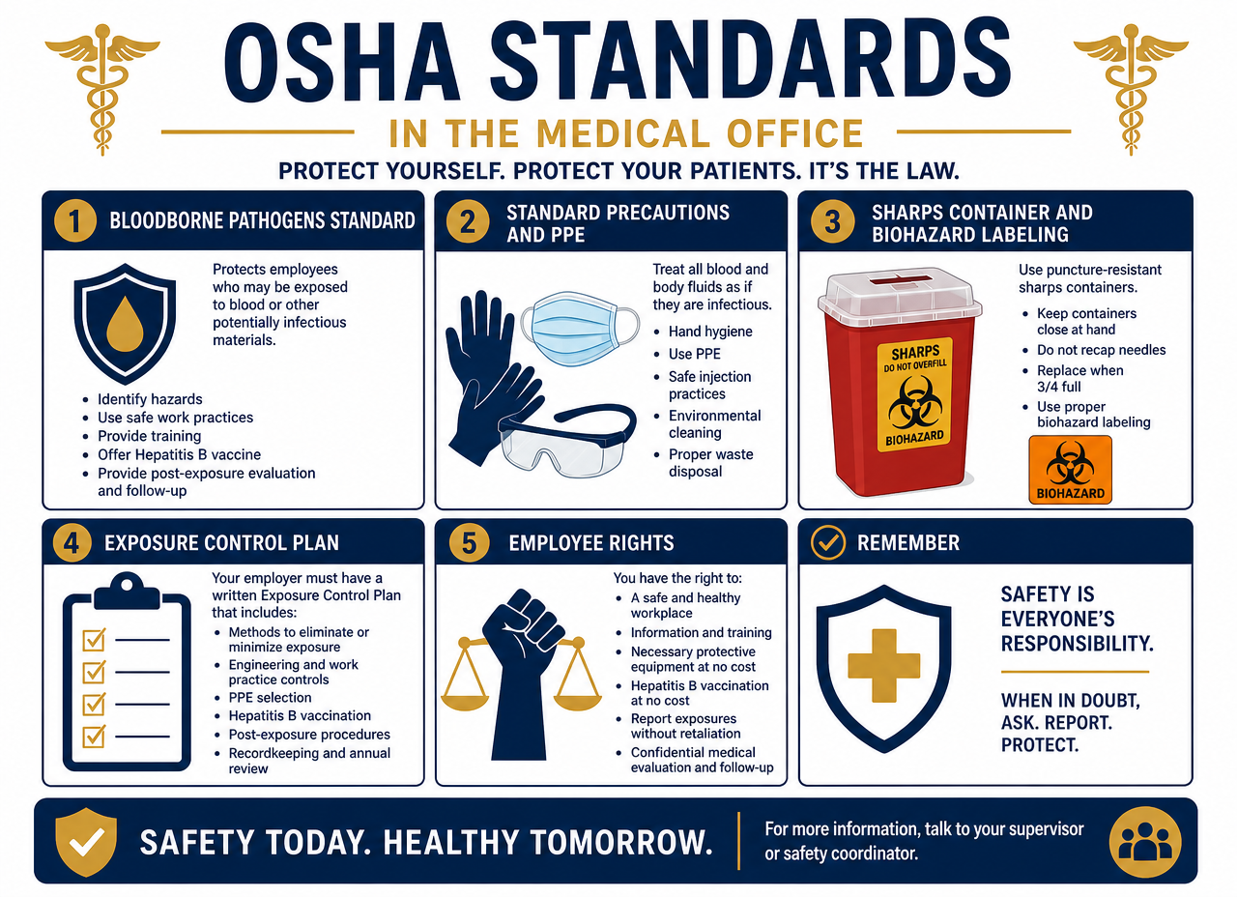
1
Legal Guidelines and Agencies
ADA · OSHA · HCS/NFPA · CMS · FDA · DEA

Slide 4
LEGAL GUIDELINES AND AGENCIES
What is a Certified Medical Assistant (CMA)?
A healthcare professional trained to perform administrative and clinical duties under the supervision of a physician.
Certification
  AAMA (American Association of Medical Assistants) grants the CMA credential.
  Accredited national exam (NBME / NPCE) with general, administrative, and clinical content.
Scope of Practice
  Acts by delegation of the physician: DOES NOT diagnose, DOES NOT prescribe, and DOES NOT interpret results.
  Must recognize their legal limits and refer to the appropriate professional.
  Essential qualities: professionalism, compassion, trustworthiness, confidentiality, and teamwork.
Legal Guidelines and Agencies
ICS · Institute of Health Sciences
4

Slide 5
LEGAL GUIDELINES AND AGENCIES
Federal Laws and Agencies Governing Practice
Acronym | Name | Purpose
ADA | Americans with Disabilities Act (1990) | Prohibits discrimination based on disability
HIPAA | Health Insurance Portability and Accountability Act | Patient information privacy and security
OSHA | Occupational Safety and Health Administration | Worker safety and bloodborne pathogens
CLIA / CMS | Clinical Laboratory Improvement Amendments | Certifies and regulates clinical laboratories
FDA | Food and Drug Administration | Approves and monitors medications and devices
DEA | Drug Enforcement Administration | Controls narcotics and controlled substances
IRS | Internal Revenue Service | Payroll, withholdings, and office taxes
Golden Rule: all CMA functions are performed within the legal framework and authorized scope of practice.
Legal Guidelines and Agencies
ICS · Institute of Health Sciences
5

Slide 6
LEGAL GUIDELINES AND AGENCIES
ADA — Americans with Disabilities Act (1990)
The Law
In Practice
Purpose
  To prohibit discrimination against individuals with disabilities in employment and services.
  To ensure equal access to healthcare.
Application
  Applies to facilities and employers with more than 15 employees.
  Includes telecommunication services for individuals with hearing or speech impairments.
Accommodations in the medical office
  Access ramps and sufficiently wide doors.
  Accessible waiting room and restroom.
  Reserved and marked parking.
  Reception desk at an accessible height.
CMA's role
  Offer assistance without assuming incapacity; communicate directly with the patient.
Legal Guidelines and Agencies
ICS · Institute of Health Sciences
6

Slide 7
LEGAL GUIDELINES AND AGENCIES
OSHA — Workplace Safety and Biohazard
Prevention
Risk Control
Hygiene and barrier protection
  Handwashing: the most effective measure (20-30 seconds).
  PPE: gloves, mask, eye protection, gown.
Waste
  Red biohazard bags for contaminated material.
  Rigid sharps containers: never recap needles.
Spills and chemicals
  Spill protocol with approved disinfectant and full PPE.
  Safety Data Sheets (SDS) accessible and chemical labeling.
Work area
  Clean areas separated from contaminated areas.
  No eating, drinking, or storing food in the specimen area.
  Immediate reporting of needlesticks and exposures.
Legal Guidelines and Agencies
ICS · Institute of Health Sciences
7

Slide 8
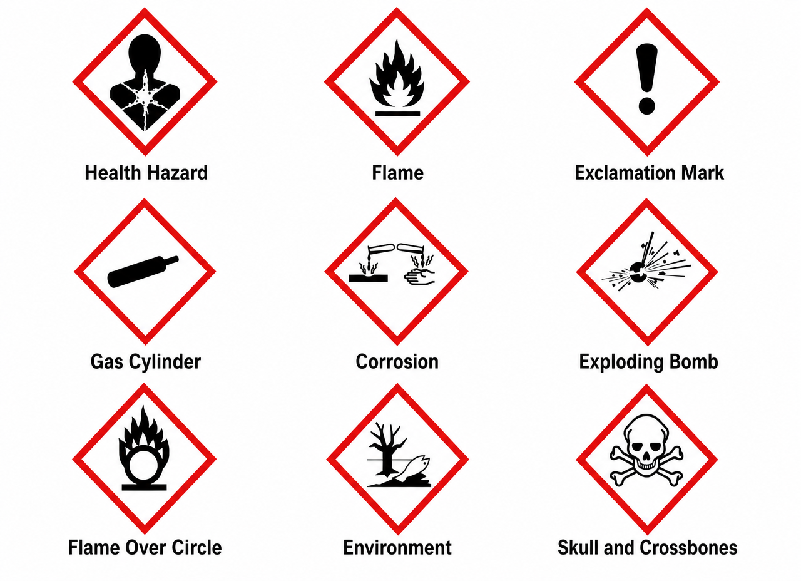
LEGAL GUIDELINES AND AGENCIES
Hazard Communication Standard (HCS)
What does the standard require?
  Every chemical label must bear pictograms warning of the hazard.
  The pictogram is a black symbol on a white background with a red diamond-shaped border.
  Each pictogram appears only once per label, even if there are multiple identical hazards.
The 9 HCS pictograms
  Health Hazard · Flame · Exclamation Mark
  Gas Cylinder · Corrosion · Exploding Bomb
  Flame Over Circle · Environment · Skull and Crossbones
Legal Guidelines and Agencies
ICS · Institute of Health Sciences
8

Slide 9
LEGAL GUIDELINES AND AGENCIES
HCS Pictograms: What Each Warns Of
Health Hazards
Physical and Toxic Hazards
Health Hazard
  Carcinogen, mutagenicity, reproductive toxicity, respiratory sensitizer, target organ toxicity, aspiration toxicity.
Flame
  Flammables, pyrophorics, self-heating, emits flammable gas, self-reactives, organic peroxides, desensitized explosives.
Exclamation Mark
  Skin and eye irritant, skin sensitizer, acute toxicity (harmful), narcotic effects, respiratory tract irritant, harmful to ozone layer.
Gas Cylinder
  Gases and chemicals under pressure.
Corrosion
  Corrosion and skin burns, eye damage, corrosive to metals.
Exploding Bomb
  Explosives, self-reactives, organic peroxides.
Flame Over Circle
  Oxidizers.
Environment / Skull
  Aquatic toxicity · Acute toxicity (fatal or toxic).
Legal Guidelines and Agencies
ICS · Institute of Health Sciences
9

Slide 10
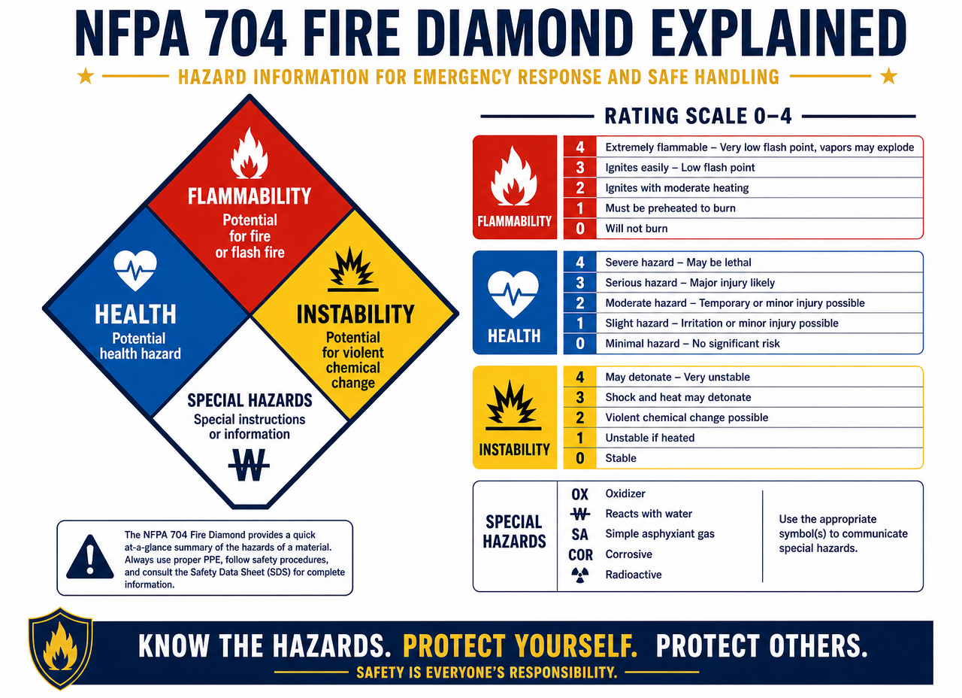
LEGAL GUIDELINES AND AGENCIES
NFPA 704 Classification Label
The Four-Color Diamond
  Blue (left) — health hazard: 4 deadly, 3 extreme danger, 2 hazardous, 1 slightly hazardous, 0 normal material.
  Red (top) — fire hazard by flash point: 4 below 73 °F, 3 below 100 °F, 2 below 200 °F, 1 above 200 °F, 0 will not burn.
  Yellow (right) — instability: 4 may detonate, 3 detonates with shock or heat, 2 violent chemical change, 1 unstable if heated, 0 stable.
White (bottom) — specific hazard
  ACID · ALK (alkali) · COR (corrosive) · OX (oxidizer) · radiation symbol · W with a slash = do not use water.
Legal Guidelines and Agencies
ICS · Institute of Health Sciences
10

Slide 11
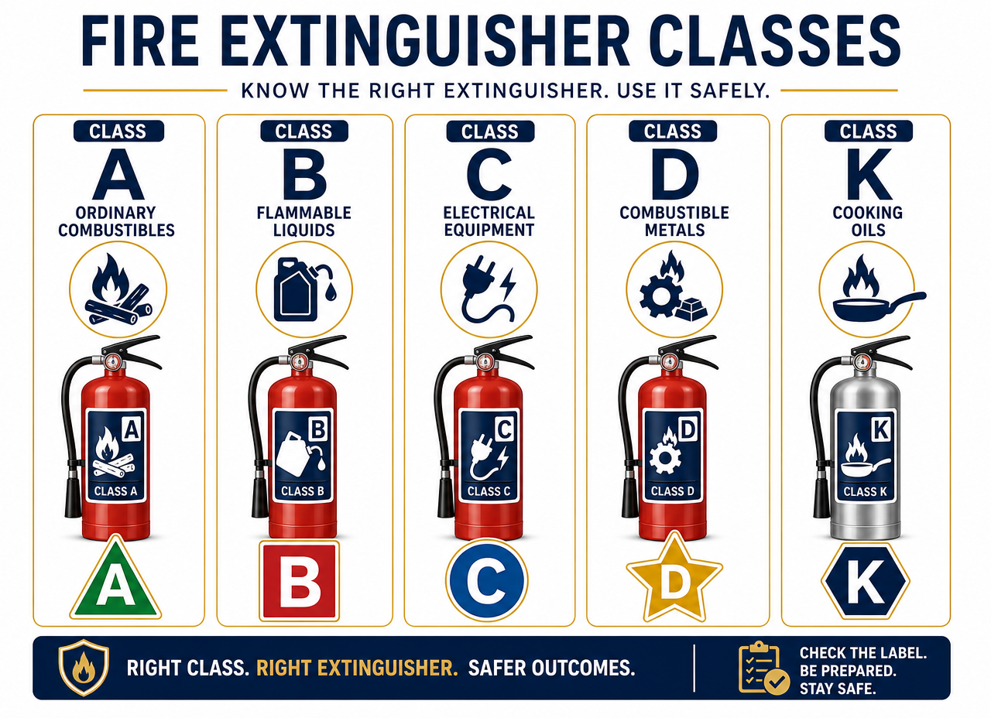
LEGAL GUIDELINES AND AGENCIES
Fire Classes and Extinguishers
Class A — green triangle
  Ordinary combustibles: wood, paper, cloth.
Class B — red square
  Flammable liquids: grease, oil, paint, solvents.
Class C — blue circle
  Live electrical equipment: electrical panel, motors, wiring.
Class D — yellow star
  Combustible metals: magnesium, aluminum.
Class K — black hexagon
  Commercial cooking equipment: cooking oils, animal and vegetable fats.
Legal Guidelines and Agencies
ICS · Institute of Health Sciences
11

Slide 12
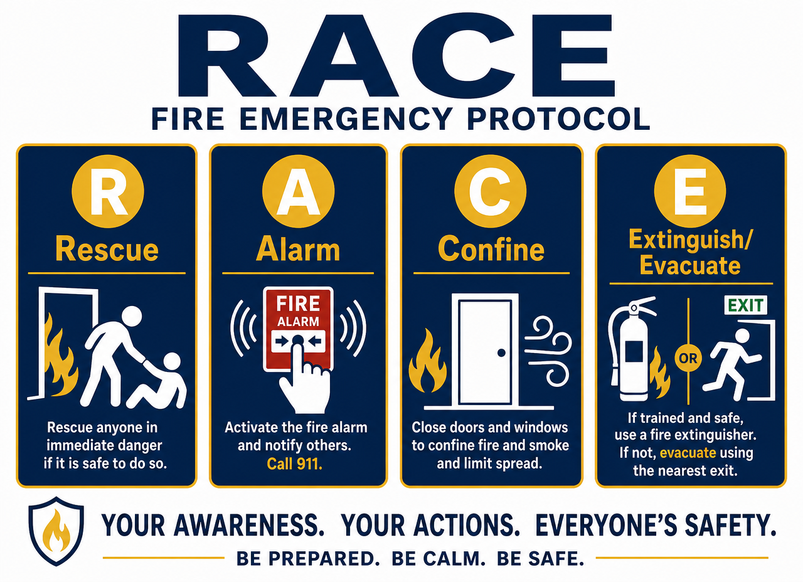
LEGAL GUIDELINES AND AGENCIES
In case of fire: remember RACE
R — Rescue
  Remove all persons in immediate danger.
A — Alarm
  Alert others by activating the fire alarm.
C — Contain
  Contain the emergency by closing doors and windows.
E — Evacuate / Extinguish
  Evacuate and extinguish the fire only if you are trained and it is safe to do so.
Using the extinguisher: PASS
  Pull (pull the pin) · Aim (aim at the base) · Squeeze (squeeze the handle) · Sweep (sweep side to side).
Legal Guidelines and Agencies
ICS · Institute of Health Sciences
12

Slide 13
LEGAL GUIDELINES AND AGENCIES
CMS / CLIA — Laboratories and records
Certification
Documentation
CMS (Centers for Medicare & Medicaid Services)
  Certifies clinical laboratories through the CLIA number.
  Requires periodic competency testing for personnel.
  Requires written policies and procedures.
  Administers Medicare and Medicaid.
Sample and record retention
  Store samples and results according to regulatory timeframes.
  Quality control and equipment maintenance records.
  Complete, legible, and auditable documentation.
  Each test is classified by complexity (waived, moderate, high).
Legal Guidelines and Agencies
ICS · Institute of Health Sciences
13

Slide 14
LEGAL GUIDELINES AND AGENCIES
FDA and DEA / IRS
FDA
DEA / IRS
FDA — Food and Drug Administration
  Assigns and requires the official generic name of the drug.
  MedWatch: adverse reaction and product failure reporting.
  Orange Book: therapeutic equivalence of generics.
  5 categories of substances based on their abuse potential.
  Drug storage temperature standards.
DEA — Drug Enforcement Administration
  Registers professionals who prescribe controlled substances.
  Requires security of narcotics and syringes under lock and key and inventory.
IRS — Internal Revenue Service
  Staff payroll, withholdings, and office tax returns.
  Retention of practice financial records.
Legal Guidelines and Agencies
ICS · Institute of Health Sciences
14

Slide 15
2
Administrative Area
Patient management, appointments, insurance, billing, and office

Slide 16
ADMINISTRATIVE AREA
Patient management: reception and registration
Patient Registration
Clinical Documentation
1. Initial reception and registration
  Complete and verified demographic data.
  Medical record number (MRN) assigned in the MPI.
  Emergency contacts and health insurance.
2. Personal information update
  Verify data at each visit; sign consents.
  Offer translation or interpreter if necessary.
3. SOAP Method
  S — Subjective: what the patient reports.
  O — Objective: vital signs and measurable findings.
  A — Assessment: physician's impression.
  P — Plan: treatment, tests, and follow-up.
4. Types of consent
  Treatment vs. information disclosure.
  The original is always filed in the medical record.
Administrative Area
ICS · Institute of Health Sciences
16

Slide 17
ADMINISTRATIVE AREA
Rules for manual entry in the medical record
Correct ink usage
  Write only with black or blue ink.
  Prohibited to use pencil, liquid correction fluid, or erase.
Correction of errors
  Cross out with a single line, write the correction, and sign with initials and date.
  The original data must remain legible.
Objectivity
  Record observable facts, not opinions or judgments.
  Quote the patient verbatim when relevant.
Real-time
  Document immediately after the procedure; never in advance.
The medical record is a legal document: if it's not written, it wasn't done.
Administrative Area
ICS · Institute of Health Sciences
17

Slide 18
ADMINISTRATIVE AREA
Types of appointment scheduling
Type | How it works | When used
Flow (per hour) | Appointments spaced at fixed intervals | General consultation with predictable times
Double booking | Two patients in the same slot | Short or follow-up visits
Walk-in | Seen on a first-come, first-served basis | Walk-in clinics
Open | No assigned time, broad window | Laboratory, vaccination
Clustering | Similar patients in the same block | Prenatal, weight control, physicals
Golden rule: never leave the patient without information about their waiting time.
Administrative Area
ICS · Institute of Health Sciences
18

Slide 19
ADMINISTRATIVE AREA
Contingencies, emergencies, and referrals
Schedule
Coordination
Contingency management
  Reserve a 20-minute block for unforeseen events.
  No-shows: document in the record and reschedule.
  Delays: inform the patient and offer options.
  Emergencies: immediate attention, notify the physician immediately.
Referrals
  Coordinate with the specialist: authorization, record, and results.
  Confirm that the patient attended and that the report arrived.
Patient advocacy
  The CMA acts as an advocate: clarifies doubts and removes access barriers.
  Retrospective review of cases to improve service.
Administrative Area
ICS · Institute of Health Sciences
19

Slide 20
ADMINISTRATIVE AREA
Office: correspondence, policies, and infection control
Staff support
Procedures
Correspondence and memos
  Memos are not signed: they are initialed.
  Sober design; they are legal evidence.
  Classify by urgency and stamp date and time of receipt.
  Log of expected mail and routing slips.
Policies, procedures, and algorithms
  P&P Manual: official office reference.
  Flowcharts and patient information brochures.
Hygiene and infection control (OSHA)
  Disinfection: eliminates microorganisms, not spores.
  Sterilization (autoclave): destroys everything, including spores.
  Daily protocol for cleaning surfaces and equipment.
Administrative Area
ICS · Institute of Health Sciences
20

Slide 21
ADMINISTRATIVE AREA
Insurance, billing, and federal programs
Billing
Coverage
Insurance and third-party payers
  Verify coverage and eligibility before the visit.
  The progress note supports everything that is billed.
  Codes: CPT-4 (procedures) and HCPCS (supplies/services).
  Submission and follow-up of claims.
Federal and state programs
  Medicare — 65+ years and certain disabilities.
  Medicaid — low income (federal and state).
  SCHIP — coverage for children.
  Tricare — military and their families.
  Workers' Compensation — work-related injuries.
Administrative Area
ICS · Institute of Health Sciences
21

Slide 22
ADMINISTRATIVE AREA
Accounts receivable and banking operations
Collections
Banking and law
Billing cycle
  Issue statement and follow up systematically.
Aging of balances
  1-30 days: gentle reminder.
  31-60 days: notice with follow-up call.
  61-90 days: formal notification and payment plan.
  More than 90 days: evaluate collection agency.
Banking operations and legality
  Detailed invoice for each service provided.
  Deposits at least weekly and bank reconciliation.
  Account types: checking, savings, and payroll.
  Consumer Protection Act: prohibits abusive collections, threats, and calls at inappropriate times.
Administrative Area
ICS · Institute of Health Sciences
22

Slide 23
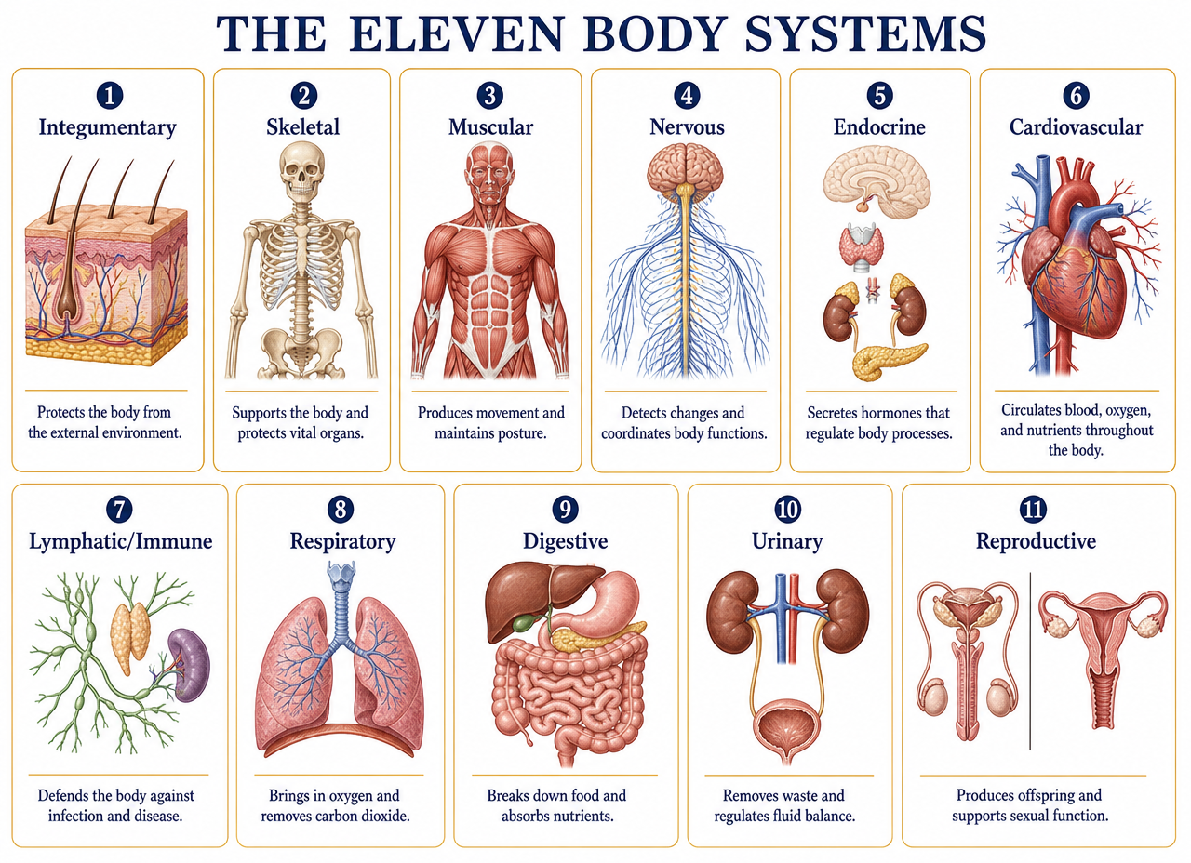
3
Anatomy: The Body Systems
The 11 systems, homeostasis, and medical terminology

Slide 24
ANATOMY: BODY SYSTEMS
The 11 Human Body Systems
System | Main Organs | Function
Integumentary | Skin, hair, nails, glands | Protective barrier and temperature
Skeletal | Bones, cartilage, ligaments | Support, protection, calcium
Muscular | Skeletal, smooth, and cardiac muscle | Movement and posture
Nervous | Brain, spinal cord, nerves | Control and interpretation of stimuli
Endocrine | Thyroid, pancreas, adrenals | Hormones and metabolism
Cardiovascular | Heart, arteries, veins, blood | Transport of O₂ and nutrients
Anatomy: Body Systems
ICS · Institute of Health Sciences
24

Slide 25
ANATOMY: BODY SYSTEMS
The 11 Human Body Systems (continued)
System | Main Organs | Function
Lymphatic / Immune | Lymph nodes, spleen, thymus, lymphocytes | Defense and fluid drainage
Respiratory | Nose, trachea, bronchi, lungs | Exchange of O₂ and CO₂
Digestive | Mouth, stomach, intestines, liver | Digestion and absorption
Urinary | Kidneys, ureters, bladder, urethra | Filters waste and balances fluids
Reproductive | Ovaries/uterus · testes/prostate | Reproduction and sex hormones
All systems work together to maintain homeostasis.
Anatomy: Body Systems
ICS · Institute of Health Sciences
25

Slide 26
ANATOMY: BODY SYSTEMS
Homeostasis and levels of organization
Internal balance
Anatomical reference
Homeostasis
  Body's ability to maintain a stable internal environment despite external changes.
  Examples: temperature 37 °C, glucose, blood pH 7.35-7.45, blood pressure.
  Maintained by negative feedback (body corrects deviation).
  When it fails, illness appears: fever, dehydration, hyper/hypoglycemia.
Levels of organization
  Cell → Tissue → Organ → System → Organism.
Positional terms
  Anterior/posterior · superior/inferior · medial/lateral.
  Proximal (near trunk) / distal (away from trunk).
  Cavities: cranial, thoracic, abdominal, and pelvic.
Anatomy: Body Systems
ICS · Institute of Health Sciences
26

Slide 27
ANATOMY: BODY SYSTEMS
Basic medical terminology
Prefixes
Suffixes
Common prefixes
  hyper- = elevated · hypo- = low.
  brady- = slow · tachy- = fast.
  a-/an- = absence · dys- = difficulty.
  peri- = around · intra- = within.
Common suffixes
  -itis = inflammation · -emia = in the blood.
  -algia = pain · -pathy = disease.
  -ectomy = removal · -otomy = incision.
  -ostomy = opening · -graphy = record/image.
Example: tachy + cardia = rapid heart rate.
Anatomy: Body Systems
ICS · Institute of Health Sciences
27

Slide 28
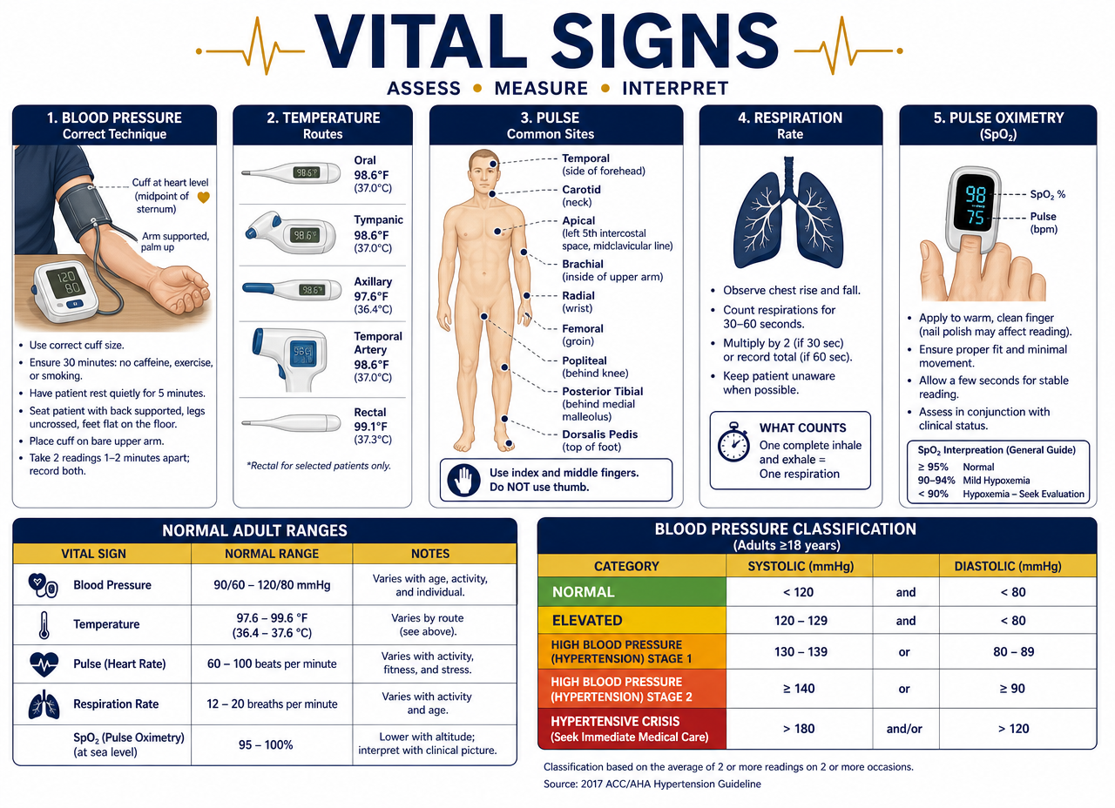
4
Vital signs and assessment
Blood pressure, temperature, ECG, oximetry and medical history

Slide 29
VITAL SIGNS AND ASSESSMENT
Blood pressure measurement
Procedure
What to avoid
Correct technique
  Patient seated, back supported, feet on floor, 5 min rest.
  Bare arm at heart level, supported.
  Appropriately sized cuff, 2.5 cm above elbow crease.
  Stethoscope over brachial artery; deflate 2-3 mmHg/second.
  Korotkoff sounds: first = systolic; disappearance = diastolic.
Common errors
  Cuff too small (falsely high reading) or too large (low).
  Arm below heart level.
  Deflating too quickly.
  Talking during measurement or crossed legs.
  Taking BP over clothing or unsupported arm.
Vital signs and assessment
ICS · Institute of Health Sciences
29

Slide 30
VITAL SIGNS AND ASSESSMENT
Classification of blood pressure in adults
Category | Systolic (mmHg) | Diastolic (mmHg)
Normal | Less than 120 | and less than 80
Elevated | 120 - 129 | and less than 80
Hypertension stage 1 | 130 - 139 | or 80 - 89
Hypertension stage 2 | 140 or more | or 90 or more
Hypertensive crisis | More than 180 | and/or more than 120
Hypertensive crisis: notify doctor immediately — it is an emergency.
Vital signs and assessment
ICS · Institute of Health Sciences
30

Slide 31
VITAL SIGNS AND ASSESSMENT
Body temperature and normal vital ranges
Temperature
Reference values
Temperature
  Oral average: 37 °C (98.6 °F); range 36.5-37.5 °C.
  Rectal and tympanic: ~0.5 °C higher than oral.
  Axillary: ~0.5 °C lower than oral.
  Influencing factors: time of day, age, exercise, ovulation, stress, environment.
  Fever: 38 °C or more. Hypothermia: less than 35 °C.
Other vital signs (adult)
  Pulse: 60-100 beats per minute, rhythmic and full.
  Respiration: 12-20 per minute.
  SpO₂: 95-100%.
  Blood pressure: less than 120/80 mmHg.
  Pain: 0-10 scale (fifth vital sign).
Vital signs and assessment
ICS · Institute of Health Sciences
31

Slide 32
VITAL SIGNS AND ASSESSMENT
Electrocardiography (ECG) and pulse oximetry
ECG
Oxygenation
ECG — basic waves
  P wave: atrial depolarization.
  QRS complex: ventricular depolarization.
  T wave: ventricular repolarization.
Types of Studies
  Resting ECG: 12 leads.
  Stress Test: 12-15 electrodes.
  Holter: 3-5 electrodes, 24-48 hours.
Pulse Oximetry (SpO₂)
  Normal: 95-100%. Hypoxia: less than 90%.
  Sensor on finger, earlobe, or foot (infants).
Accuracy Limitations
  Nail polish, acrylic nails, poor circulation.
  Movement, intense light, hypothermia.
Gas Transport
  O₂: 98.5% bound to hemoglobin.
  CO₂: HCO₃⁻ ~70%, carbaminohemoglobin ~20-23%, plasma ~7-10%.
Vital signs and assessment
ICS · Institute of Health Sciences
32

Slide 33
VITAL SIGNS AND ASSESSMENT
Initial Interview, Medical History, and Asepsis
Documentation
Asepsis
H&P Report (History and Physical)
  Acute patients: within 24 hours.
  Chronic patients: within 30 days.
Components of the Medical History
  Chief Complaint.
  History of Present Illness.
  Medical, Surgical, and Medication History.
  Family and Social History.
  Review of Systems (ROS).
Medical Asepsis (Clean Technique)
  Reduces the number of microorganisms.
  Hand washing for 20-30 seconds.
Surgical Asepsis (Sterile Technique)
  Eliminates all microorganisms, including spores.
  Sterile field: never turn your back or reach over.
  Anything below waist level is considered contaminated.
Vital signs and assessment
ICS · Institute of Health Sciences
33

Slide 34
VITAL SIGNS AND ASSESSMENT
Patient Positions, Safety, and Medications
Positions
Safety and Limits
Examination Positions
  Trendelenburg: supine with head lower than feet (shock).
  Sims: left lateral with knee flexed (rectal, enemas).
  Orthopneic: sitting upright leaning forward (respiratory distress).
  Always drape the patient and respect their privacy.
Safety and Patient-Owned Equipment
  NFPA (fire) and JCAHO (accreditation and safety) standards.
  Admission protocol: identify patient-owned equipment (oxygen, CPAP, cane).
  Document life support restrictions (DNR / advance directives).
Self-Administered Medications
  The CMA can prepare, verify, and educate; does not prescribe or adjust doses.
Vital signs and assessment
ICS · Institute of Health Sciences
34

Slide 35
5
Physical Examination Preparation
Visual Acuity, Audiological, and Pulmonary Function Tests

Slide 36
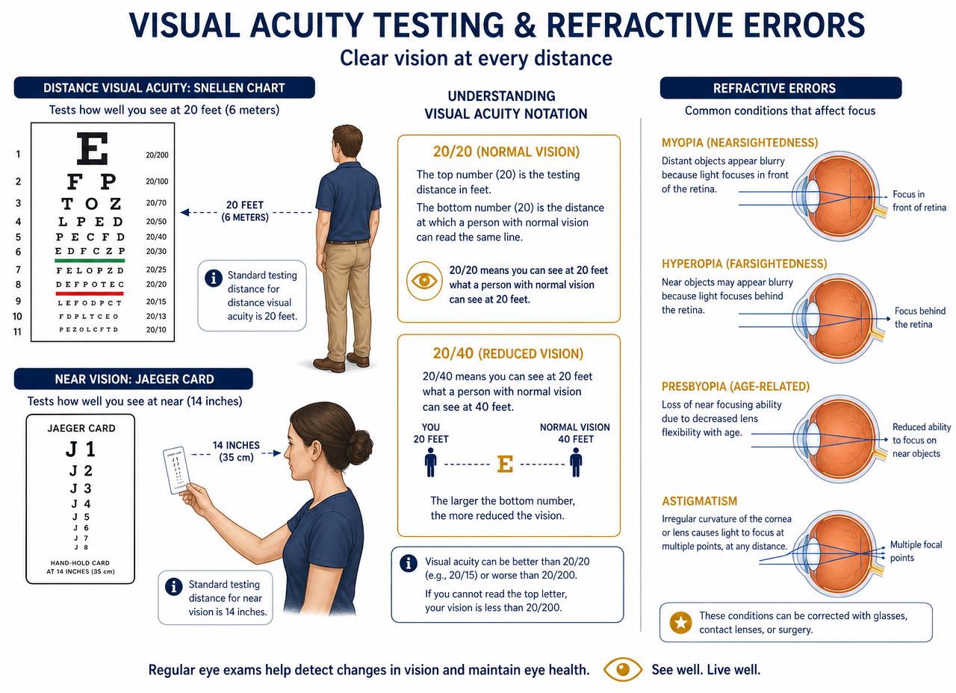
PHYSICAL EXAMINATION PREPARATION
Visual Acuity Tests
Procedure
Refractive Errors
Distance Vision — Snellen Chart
  Distance: 6 meters (20 feet).
  Test with correction (glasses/lenses) and then without.
  Cover one eye without applying pressure.
  Interpretation 20/40: the patient sees at 20 feet what a normal person sees at 40.
Near Vision — Jaeger Card
  Distance: 35.5 cm (14 inches).
Myopia
  Long eyeball; poor distance vision.
Hyperopia
  Short or weak eyeball; poor near vision.
Presbyopia
  Loss of lens elasticity due to age (approx. 45 years).
Astigmatism
  Irregular corneal curvature causing blurred vision.
Physical Examination Preparation
ICS · Institute of Health Sciences
36

Slide 37
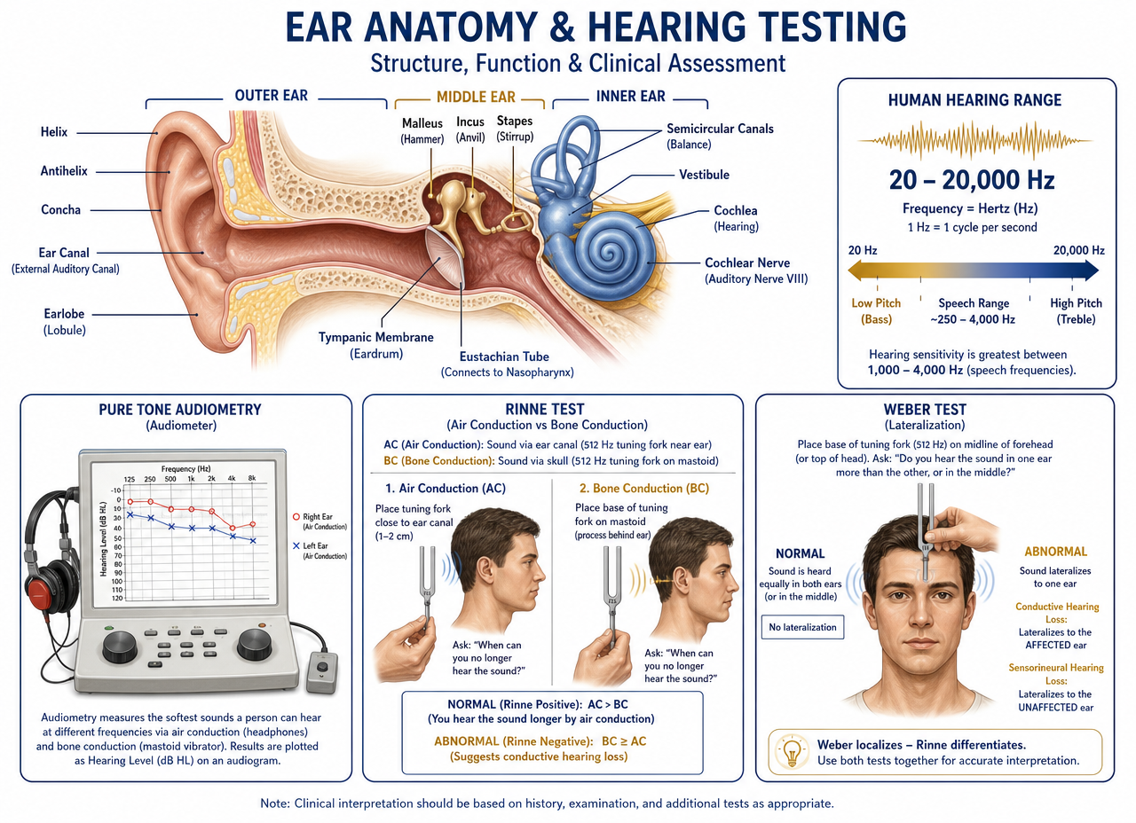
PHYSICAL EXAMINATION PREPARATION
Audiological Tests
Measure hearing in terms of Intensity (Decibels · dB) and Pitch (Hertz · Hz).
Normal range: 20 Hz to 20,000 Hz. Human speech is between 500 and 3,000 Hz.
Hearing loss: suspected if the patient cannot hear below 25 dB.
Sounds greater than 85 dB are damaging.
Conduction Tests:
  Air: tuning fork to the sides of the head or headphones.
  Bone: tuning fork or vibrator over the mastoid bone (behind the ear).
Physical Examination Preparation
ICS · Institute of Health Sciences
37

Slide 38
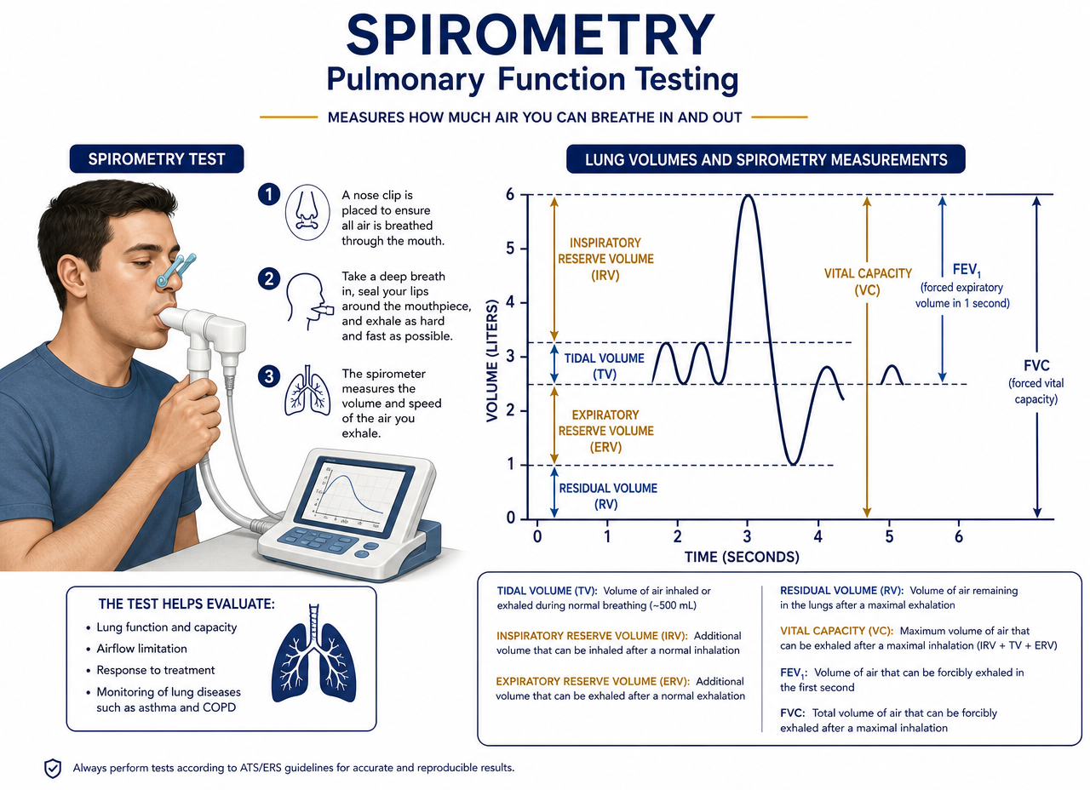
PHYSICAL EXAMINATION PREPARATION
Pulmonary Function Tests (PFTs)
The spirometer measures lung capacity and volume.
Technique
  Patient seated, with nose clip.
  Inhale deeply and exhale forcefully for 6 seconds.
  The best of 3 readings is taken.
Key Definitions
  Tidal Volume (TV): normal breathing.
  Vital Capacity: tidal volume + inspiratory and expiratory reserves.
  Residual Volume (RV): air always remaining in the lungs to prevent collapse.
Physical Examination Preparation
ICS · Institute of Health Sciences
38

Slide 39
6
Supportive Anatomy and Physiology
Heart and Circulation · Gas Exchange · Nervous System

Slide 40
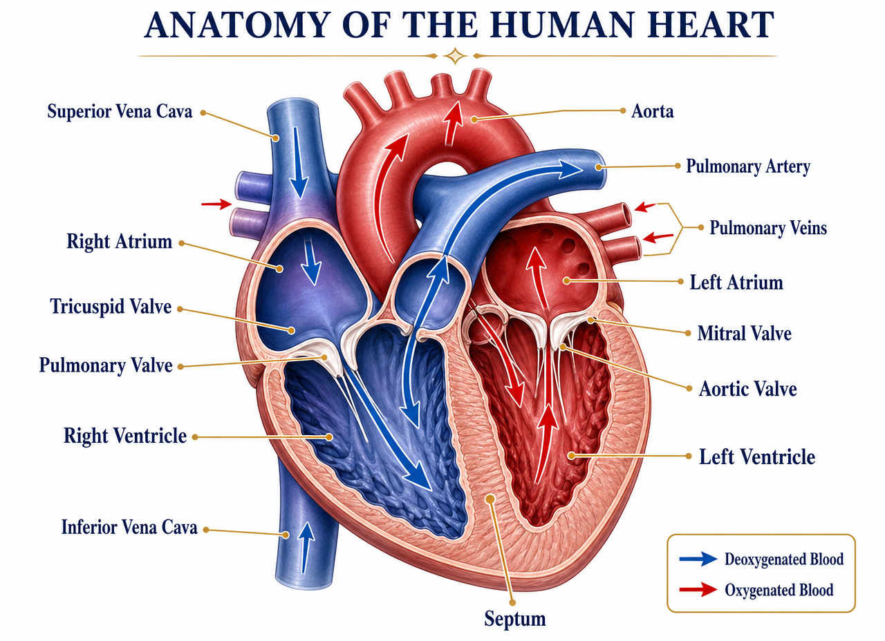
SUPPORTIVE ANATOMY AND PHYSIOLOGY
The Heart: Chambers, Valves, and Great Vessels
4 chambers
  Atria (right and left): receive blood.
  Ventricles (right and left): pump blood out.
4 valves
  Tricuspid: atrium → right ventricle.
  Pulmonary: right ventricle → pulmonary artery.
  Mitral (bicuspid): atrium → left ventricle.
  Aortic: left ventricle → aorta.
  Prevent blood backflow.
Septum
  Separates the right side (O₂-poor blood) from the left (O₂-rich blood).
Supportive Anatomy and Physiology
ICS · Institute of Health Sciences
40

Slide 41
SUPPORTIVE ANATOMY AND PHYSIOLOGY
Blood Flow: Entry and Exit
Pulmonary Circulation (Lesser)
Systemic Circulation (Greater)
OXYGEN-POOR blood ENTERS
  1. Superior and inferior vena cava → right atrium.
  2. Tricuspid valve → right ventricle.
  3. Pulmonary valve → pulmonary artery.
  4. EXITS to the lungs: CO₂ is released and O₂ is taken up.
Note: the pulmonary artery is the only artery that carries oxygen-poor blood.
OXYGEN-RICH blood RETURNS
  5. Pulmonary veins → left atrium.
  6. Mitral valve → left ventricle.
  7. Aortic valve → aorta.
  8. EXITS to the entire body via the arteries.
Note: the pulmonary veins are the only veins that carry oxygen-rich blood.
Supportive Anatomy and Physiology
ICS · Institute of Health Sciences
41

Slide 42
SUPPORTIVE ANATOMY AND PHYSIOLOGY
Cardiac Cycle: Key Data for the CMA
Systole and Diastole
  Systole: contraction; the ventricle expels blood (high number of blood pressure).
  Diastole: relaxation; the chambers fill (low number of blood pressure).
Heart Sounds
  "Lub" (S1): closure of the tricuspid and mitral valves.
  "Dub" (S2): closure of the pulmonary and aortic valves.
Conduction System
  SA node (natural pacemaker) → AV node → Bundle of His → Purkinje fibers.
Coronary Circulation
  Coronary arteries nourish the heart muscle itself; their obstruction causes myocardial infarction.
Supportive Anatomy and Physiology
ICS · Institute of Health Sciences
42

Slide 43
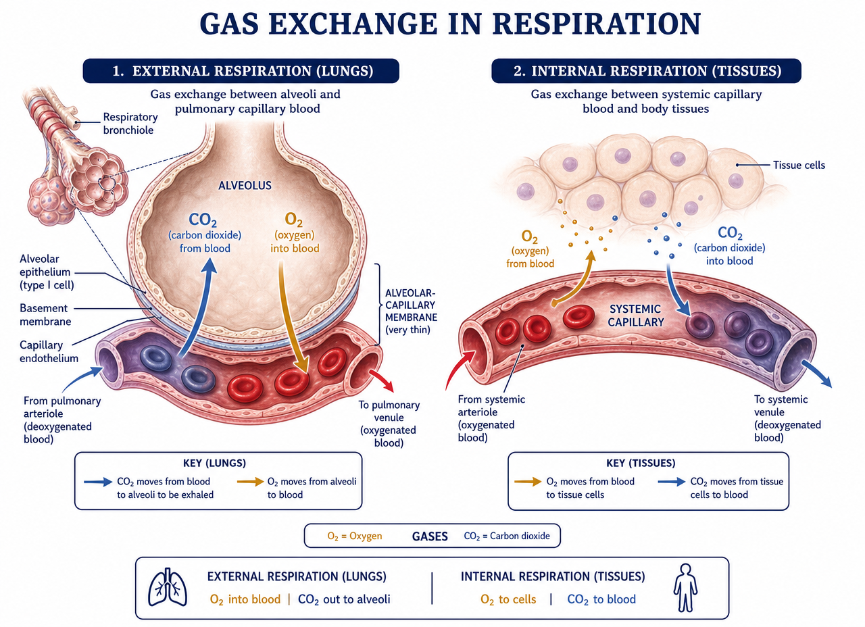
SUPPORTIVE ANATOMY AND PHYSIOLOGY
Gas Exchange
Vital process of oxygen (O₂) and carbon dioxide (CO₂) diffusion across alveolar-capillary membranes, in the lungs and tissues, facilitated by pressure gradients (simple diffusion).
External Respiration (Lungs)
  Inhaled oxygen enters the alveoli and diffuses into the blood (from high to low pressure).
  CO₂ from the blood passes into the alveoli to be exhaled.
Internal Respiration (Tissues)
  O₂ diffuses from the capillaries into the cells for cellular respiration.
  CO₂ (waste) diffuses from the cells into the blood.
Blood in the pulmonary capillaries is low in O₂ and high in CO₂.
Supportive Anatomy and Physiology
ICS · Institute of Health Sciences
43

Slide 44
SUPPORTIVE ANATOMY AND PHYSIOLOGY
Nervous System
General Organization
Lobes and Structures
Complex biological network that controls, coordinates, and regulates bodily functions and interactions with the environment.
Structural Division
  CNS (Central): processing and command center — brain and spinal cord.
  PNS (Peripheral): connects the CNS to the rest of the body.
Functional Division
  Somatic: voluntary actions.
  Autonomic: involuntary, divided into sympathetic and parasympathetic.
The basic functional unit is the neuron; it transmits impulses via dendrites and axons.
Frontal Lobe
  Speech, motor control, cognitive skills.
Parietal Lobe
  Touch, pressure, taste, spatial awareness.
Temporal Lobe
  Hearing, facial recognition, processing memory.
Occipital Lobe
  Vision.
Cerebellum
  Coordination and balance.
Spinal Cord
  Transmits messages between the brain and nerve pathways.
Supportive Anatomy and Physiology
ICS · Institute of Health Sciences
44

Slide 45
7
Laboratory Procedures
Venipuncture, Capillary Puncture, Urine, Stool, and Diagnostic Imaging

Slide 46
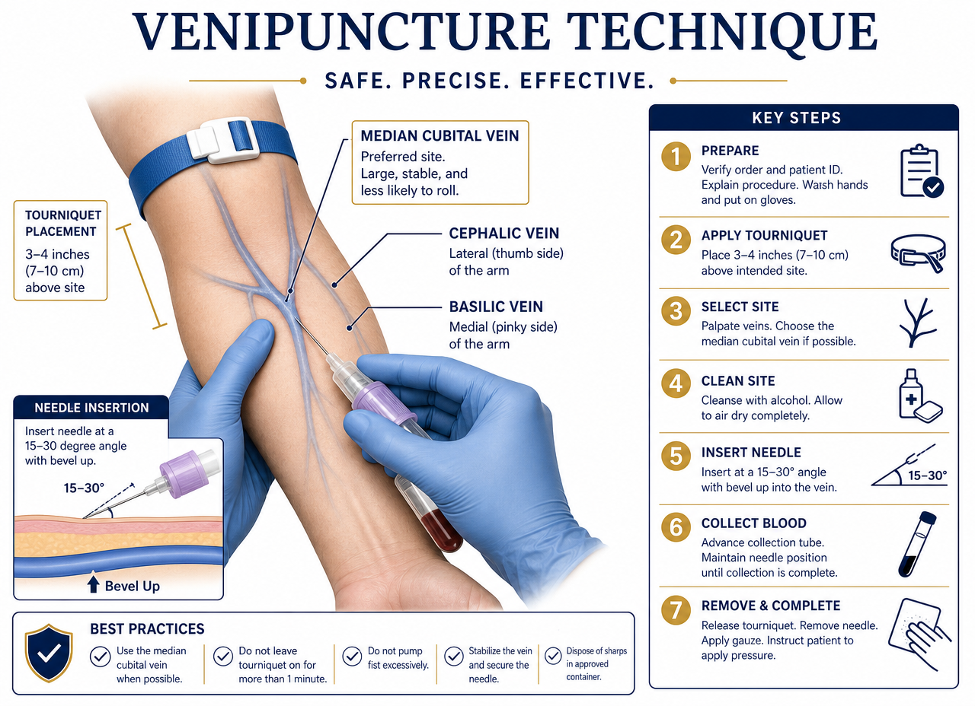
LABORATORY PROCEDURES
Venipuncture: Protocol and Safety
Identification and Consent
Extraction Technique
Verify identity (wristband/card) and concordance with the request. If there is a discrepancy, STOP.
Right to refuse: a conscious adult can refuse; proceeding without permission is legal assault.
Implied consent: applies only if the patient is unconscious.
Insertion angle: 30° with the bevel facing up.
Tourniquet: do not leave on for more than 1-2 minutes (prevents hemoconcentration and false calcium levels).
Post-puncture: constant pressure for 4 to 6 minutes (longer if taking anticoagulants). Do not bend the arm.
Laboratory Procedures
ICS · Institute of Health Sciences
46

Slide 47
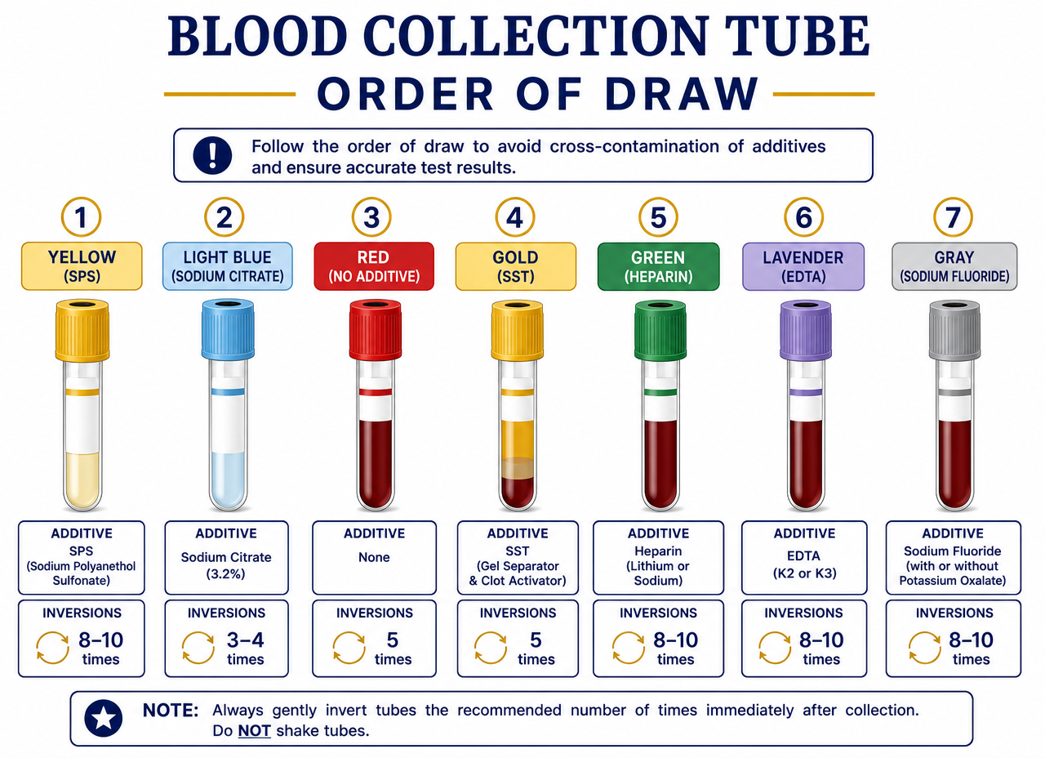
LABORATORY PROCEDURES
Order of Tube Filling
Color | Additive | Order | Main Use | Inversions
Yellow | SPS | First | Blood Culture | 8-10 times
Light Blue | Sodium Citrate | Second | Coagulation (PT, PTT, INR) | 3-4 inversions
Red | None | Third | Chemistry / Serology | Do not mix
Gold (SST) | Separator Gel + Activator | Fourth | Serum Chemistry | 5 times
Green | Heparin | Fifth | Plasma Chemistry | 8-10 times
Lavender | EDTA | Sixth | Hematology | 8-10 times
Gray | Fluoride / Oxalate | Seventh | Glucose · Lactate | 8-10 times
The order prevents cross-contamination of additives between tubes.
Laboratory Procedures
ICS · Institute of Health Sciences
47

Slide 48
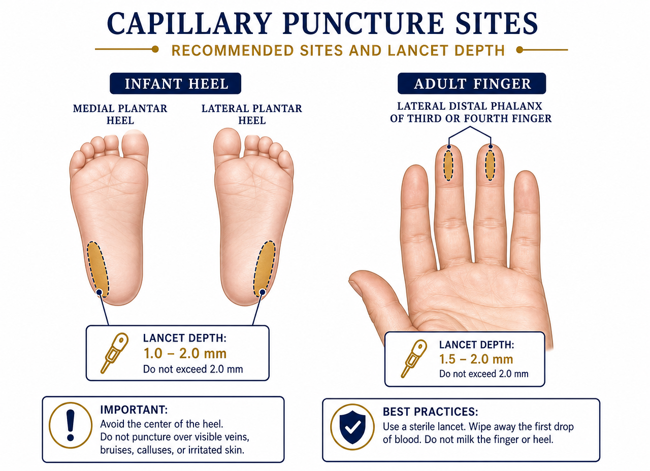
LABORATORY PROCEDURES
Capillary Puncture: Procedure and Sites
Used for small amounts of blood (blood glucose, neonatal PKU) or when veins are difficult.
Puncture Sites
  Newborns: lateral or medial plantar surface of the heel (avoid the calcaneus bone).
  Adults: palmar surface of the distal phalanx (fingertip).
Laboratory Procedures
ICS · Institute of Health Sciences
48

Slide 49
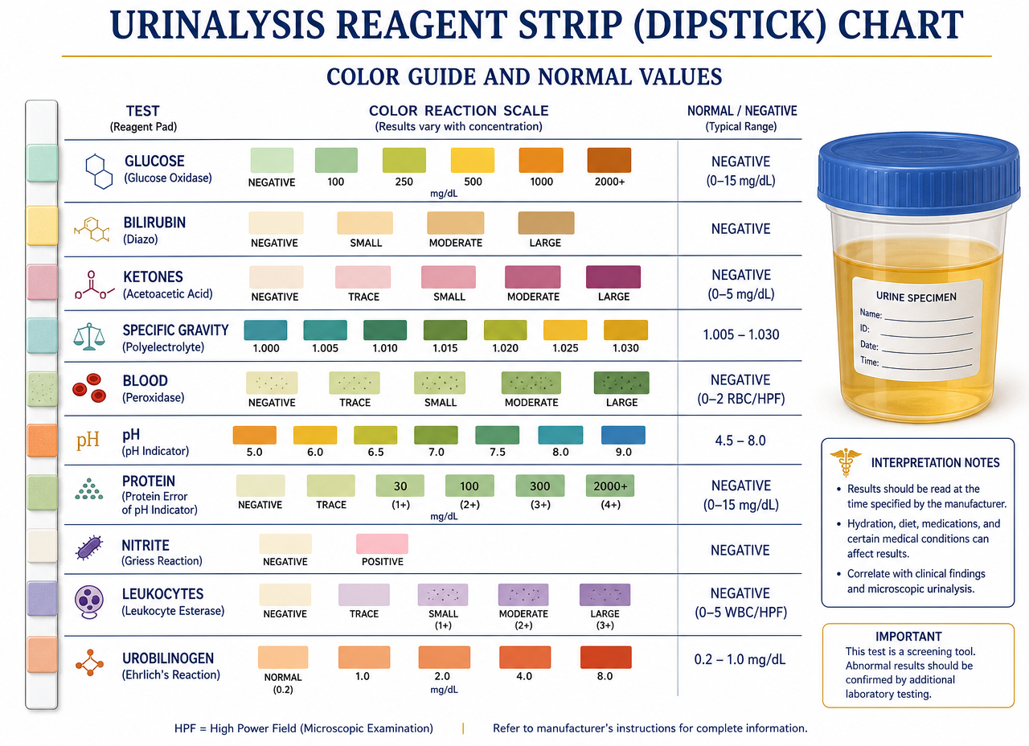
LABORATORY PROCEDURES
Urine Analysis (N-Multistix)
Rapid interpretation of reagent strips for health screening.
Blood / Leukocytes: indicate infection or trauma.
Glucose / Ketones: markers of uncontrolled diabetes or malnutrition/extreme diets.
Nitrites: presence of bacteria (such as E. coli).
pH (5 to 9): acidic urine resists infections; alkaline urine promotes bacterial growth.
Proteins: if present, suggest damage to the nephrons (kidneys).
Laboratory Procedures
ICS · Institute of Health Sciences
49

Slide 50
LABORATORY PROCEDURES
Stool Collection and Occult Blood
Detection of parasites and microscopic bleeding.
O&P (ova and parasites): a teaspoon of stool is mixed in formalin.
Pinworms (tape test): collected at night or upon waking, by touching the anus with tape or a paddle.
Occult Blood (Guaiac)
  Prior diet (3 days): avoid melon, turnip, broccoli, and radish (cause false positives).
  Rapid test: if the sample with peroxide turns blue in 2 seconds, it is positive for blood.
Laboratory Procedures
ICS · Institute of Health Sciences
50

Slide 51
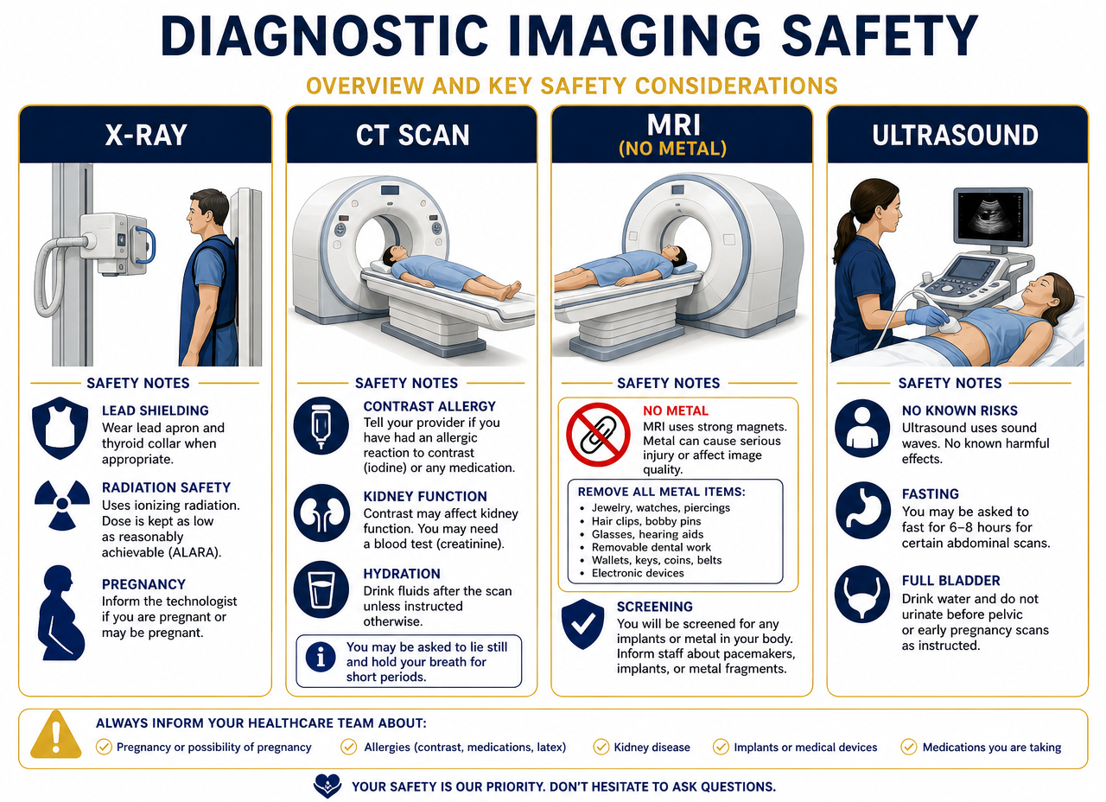
LABORATORY PROCEDURES
Imaging Diagnostics and Safety
X-rays, CT, MRI, and Ultrasound
Contrast, Allergies, and Preparation
MRI (Magnetic Resonance Imaging) Safety: crucial! The magnet is extremely powerful.
Prohibited: pacemakers, metal clips, jewelry, hearing aids, credit cards (will be erased), and metal objects in body piercings (will heat up).
Tattoos: inform the technician if recent (can cause burns).
Always verify allergies to iodine / contrast media and latex.
For women of childbearing age, mandatory pregnancy test before an MRI or X-ray.
Preparation: inform about fasting (8 h) or prior water/laxative intake depending on the study.
Laboratory Procedures
ICS · Institute of Health Sciences
51

Slide 52
8
Laboratory Sample Processing
Hematology, Coagulation, Biochemistry, and Lipid Profile

Slide 53
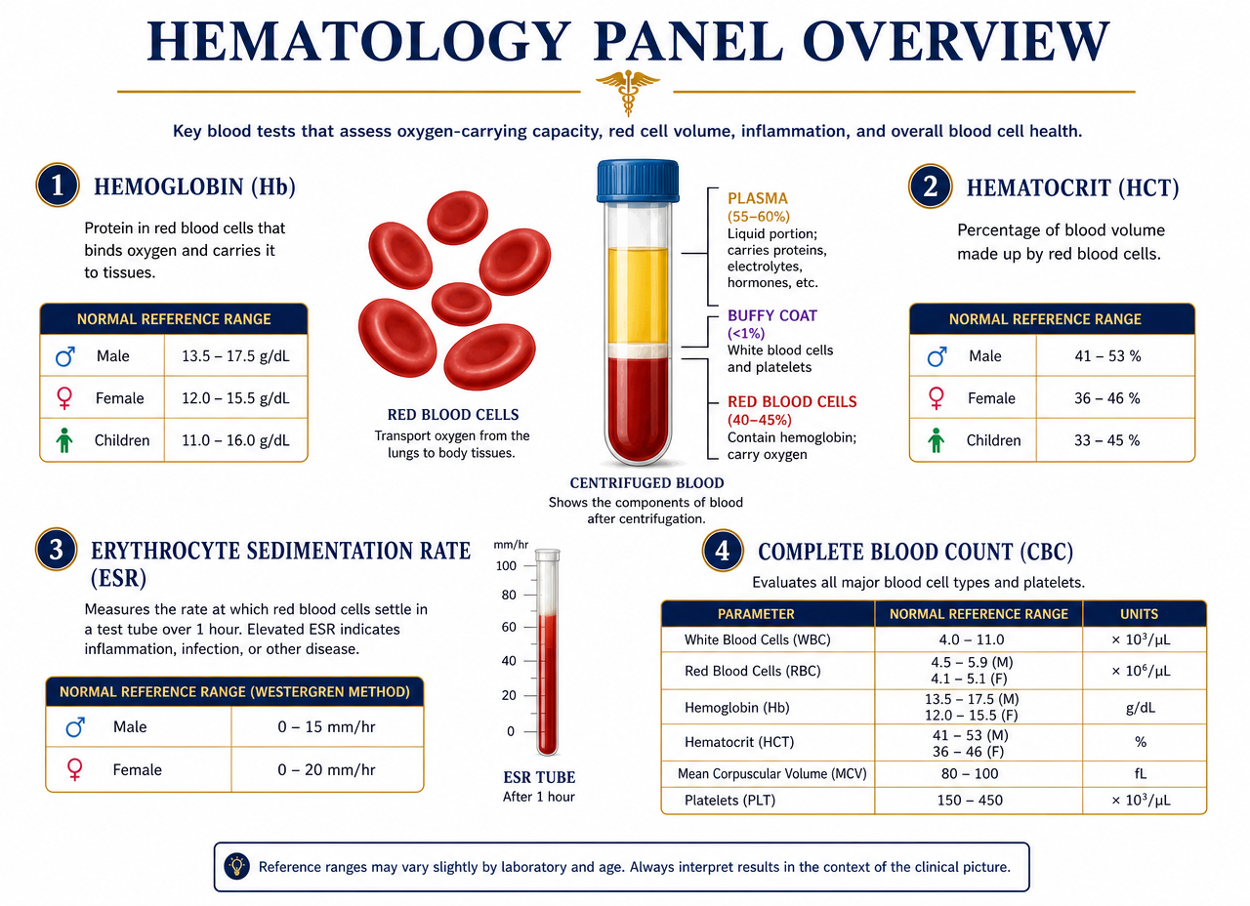
LABORATORY SAMPLE PROCESSING
Hematology
Hemoglobin (Hb)
  Complex protein composed of heme (containing iron) and globin chains.
  Normal values: women 12-16 g/dL · men 14-16 g/dL.
Hematocrit (Hct)
  Percentage of packed red blood cells.
  Values: men 42-52% · women 36-48%.
Erythrocyte Sedimentation Rate (ESR)
  Measures the distance and time in which rouleaux (aggregates) are formed.
  Elevated ESR: indicates inflammation, necrosis, or infection (not diagnostic on its own).
  Values: men 0-15 mm/h · women 0-20 mm/h.
Laboratory Sample Processing
ICS · Institute of Health Sciences
53

Slide 54
LABORATORY SAMPLE PROCESSING
Anticoagulation Monitoring
Critical tests for patients at risk of thrombosis or on Warfarin treatment.
INR (International Normalized Ratio): is the current global standard.
  Normal: 0.9 to 1.2.
  Therapeutic: 2.0 to 3.0 (up to 3.5 in high risk of clots).
  Hemorrhage: INR of 3.0 to 4.5 indicates significant bleeding.
PT (Prothrombin Time): normal 10-12 sec. Evaluates factors VII to I.
aPTT (Activated Partial Thromboplastin Time): normal 25-38 sec. Evaluates factors XII to I.
Laboratory Sample Processing
ICS · Institute of Health Sciences
54

Slide 55
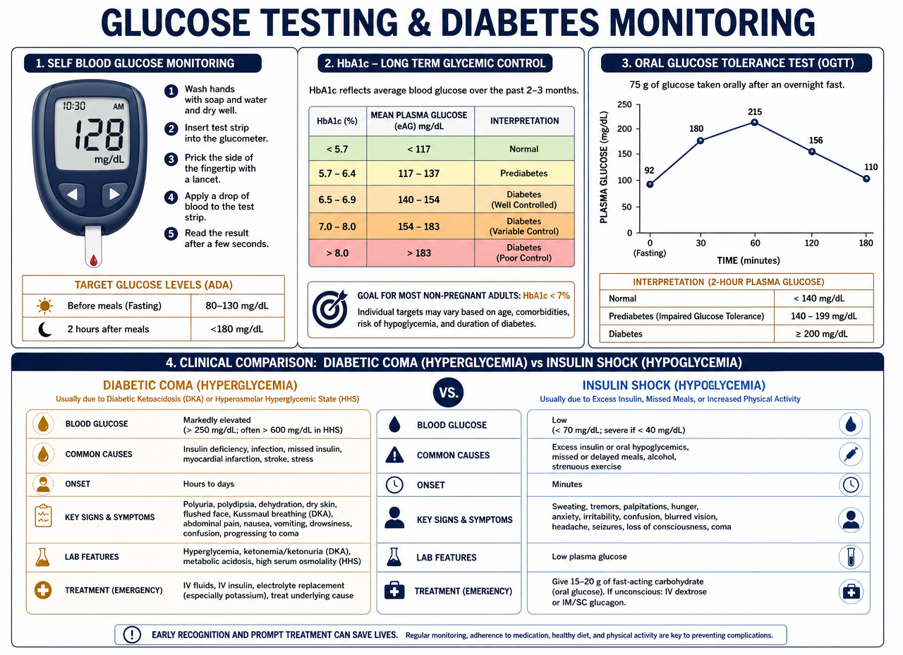
LABORATORY SAMPLE PROCESSING
Biochemistry: Glucose and Renal Function
Diabetes
Renal Profile
HbA1c
  Reflects glucose control over the last 3 months (red blood cell lifespan).
OGTT (Oral Glucose Tolerance Test)
  Diagnosis of prediabetes; fasting samples and after glucose load.
BUN (Urea Nitrogen)
  Normal 7-18 mg/dL. Elevated in ESRD (60-100 mg/dL).
Creatinine
  Product of muscle metabolism. Elevated (>1.5 mg/dL) indicates kidney failure.
Albumin
  Its deficiency causes edema (swelling).
Laboratory Sample Processing
ICS · Institute of Health Sciences
55

Slide 56
LABORATORY SAMPLE PROCESSING
Biochemistry: Liver Function and Lipid Profile
Liver
Lipids
Alkaline Phosphatase (ALP)
  Differentiates bone from liver disease.
ALT / AST
  Ideal ratio 1:1. Alterations indicate hepatitis (less than 1:1) or cirrhosis (greater than 1:1).
Bilirubin
  Bile pigment. Its excess causes jaundice. Light sensitive.
Requires 12-14 hours of fasting.
Total cholesterol: desirable <200 mg/dl.
LDL (bad): optimal <100 mg/dl.
HDL (good): >40 (M) / >50 (F).
Triglycerides: normal <150 mg/dl.
Laboratory Sample Processing
ICS · Institute of Health Sciences
56

Slide 57
9
Technical Care and Emergencies
Injections, Cold Chain, Crash Cart, Triage and Urgent Care

Slide 58
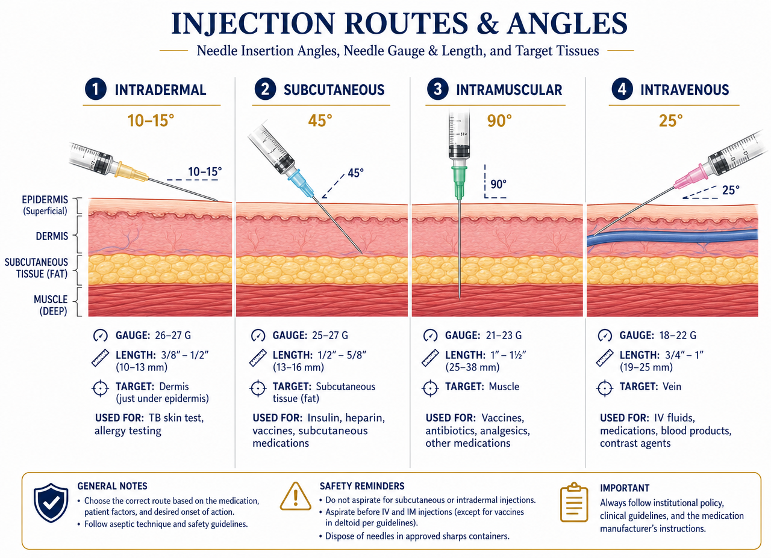
TECHNICAL CARE AND EMERGENCIES
Administration Routes and Injections
Injection Type | Angle | Needle (gauge/length) | Max. Amount | Common Site
Subcutaneous (SC) | 45° | 24-25G / 1.27 cm | 0.5 ml | Abdomen, arm (fat)
Intramuscular (IM) | 90° | 20-22G / 2.54 cm | 5.0 ml | Deltoid, gluteus, vastus lateralis
Intradermal (ID) | 10-15° | 26-27G / short bevel | 0.1 ml | Forearm (TB test)
The chosen route depends on urgency and drug solubility.
Technical Care and Emergencies
ICS · Institute of Health Sciences
58

Slide 59
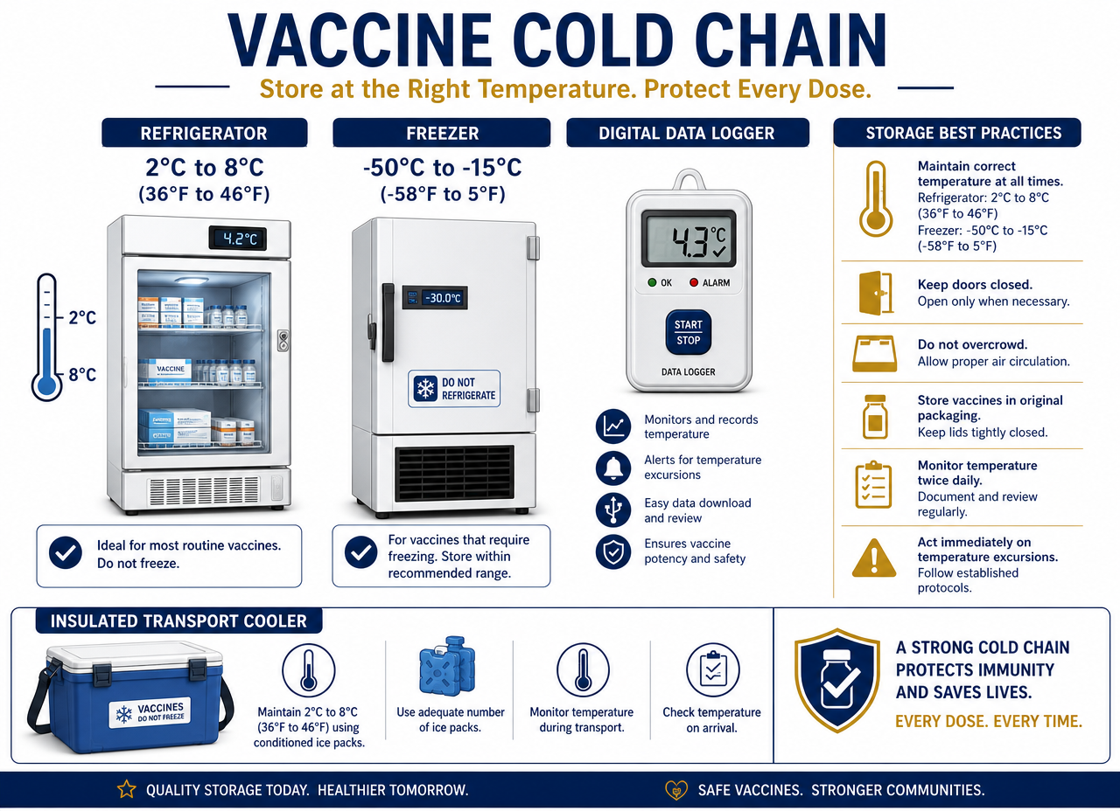
TECHNICAL CARE AND EMERGENCIES
Cold Chain and Vaccine Storage
Incorrect storage degrades the biological product before its expiration.
Refrigerator: ideal 5 °C (range 2 °C to 8 °C).
Freezer (MMR/Varicella): ideal -18 °C (range -15 °C to -20 °C).
Protocol
  NEVER store in the refrigerator door.
  Record temperature 2 times a day (start and end of shift).
  Rotate inventory weekly (oldest in front).
  Prohibited: storing food or biological samples with vaccines.
Technical Care and Emergencies
ICS · Institute of Health Sciences
59

Slide 60
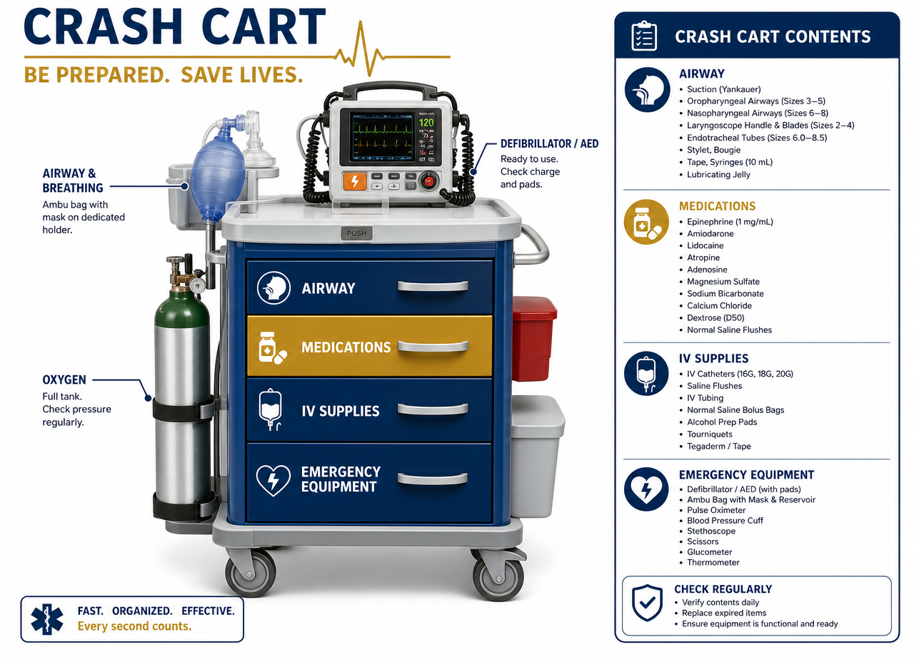
TECHNICAL CARE AND EMERGENCIES
Resuscitation Cart (Crash Cart)
Contents
MA Role in Emergencies
The MA must know the location and contents of the "crash cart".
Oxygen tank (green).
Defibrillator (AED).
Masks.
Emergency medications.
Activate the emergency system (911).
Place the patient in Trendelenburg position (feet elevated) or recovery position.
Administer oxygen (2 to 4 L/min) if indicated.
Prepare the AED and assist with CPR.
Technical Care and Emergencies
ICS · Institute of Health Sciences
60

Slide 61
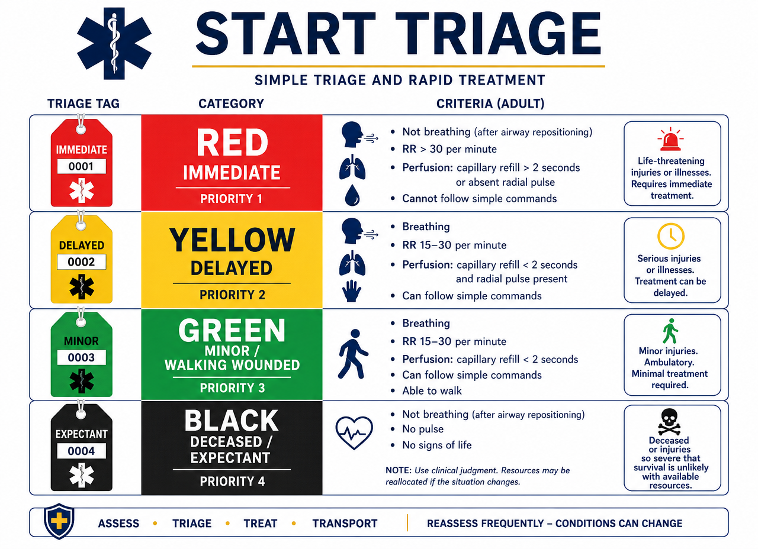
TECHNICAL CARE AND EMERGENCIES
Triage and START System
Assessment
Color Coding
Prioritization of victims in mass casualty incidents.
RPM Assessment (30 seconds)
  Respiration.
  Perfusion (radial pulse / capillary refill).
  Mental status.
Red (Priority 1): immediate. Treatable life-threatening risk.
Yellow (Priority 2): delayed. Serious but stable injuries.
Green (Priority 3): "walking wounded". Can walk.
Black: deceased or injuries incompatible with life.
Technical Care and Emergencies
ICS · Institute of Health Sciences
61

Slide 62
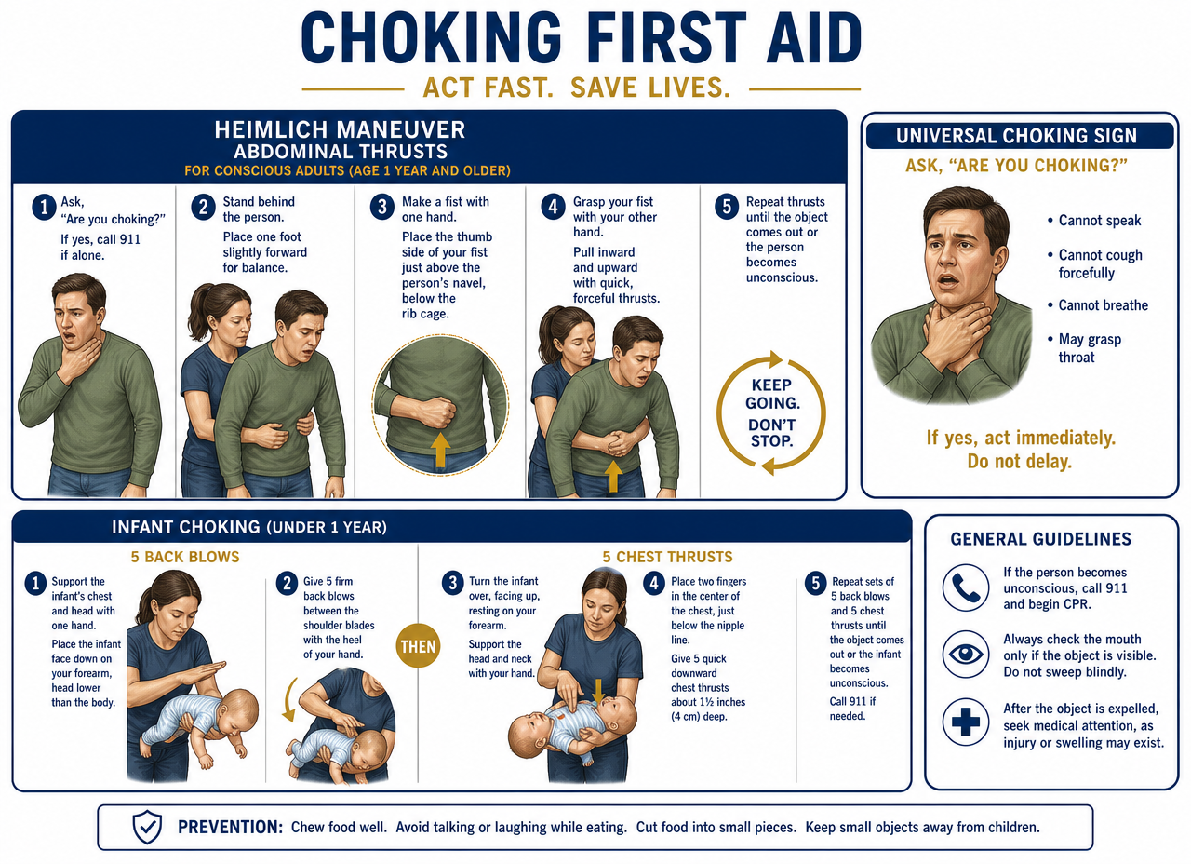
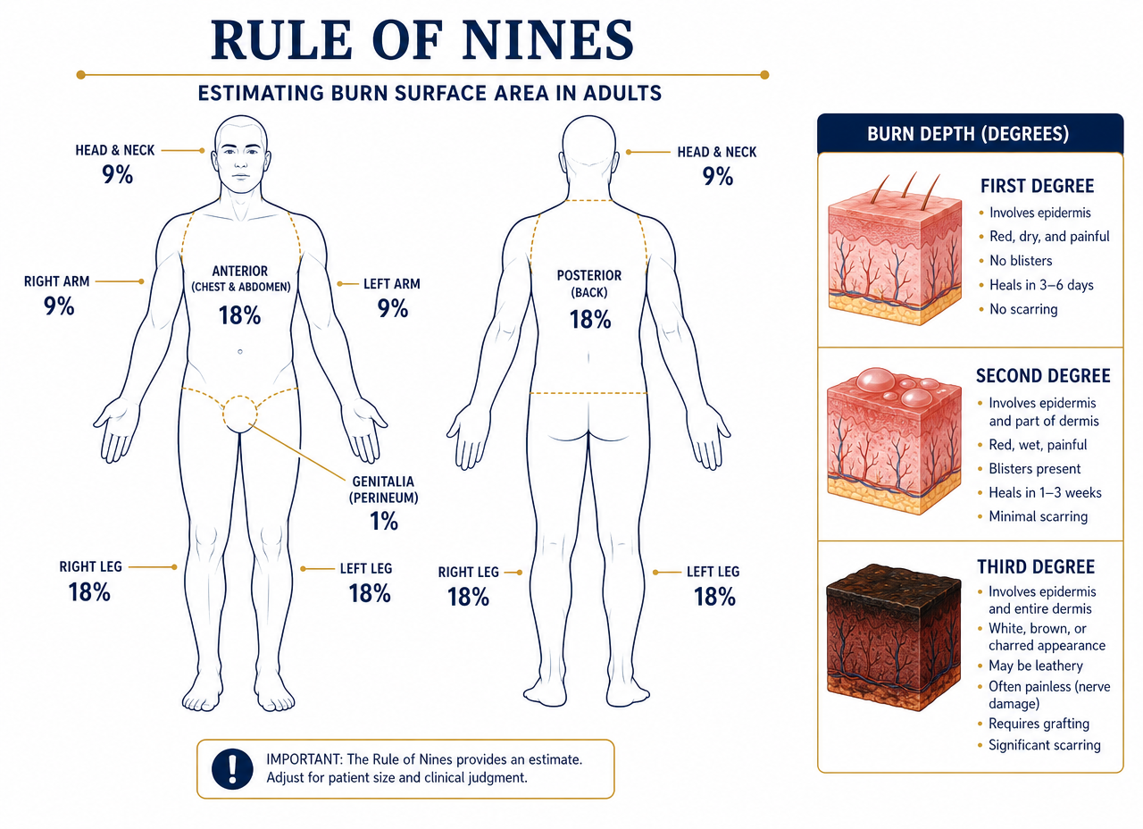
TECHNICAL CARE AND EMERGENCIES
First Aid: Burns and Choking
Burns
Asphyxia (Choking)
Rule of Nines
  Evaluates the % of total body surface area (TBSA) to decide transfer to a burn unit.
Treatment
  Cold water for 20 minutes.
  DO NOT use ice or butter.
  Cover with loose sterile gauze.
Universal sign: hands to throat.
Heimlich maneuver: subdiaphragmatic compressions until the object is expelled or the patient loses consciousness.
Unconscious: initiate CPR and perform a finger sweep if the object is visible.
Technical Care and Emergencies
ICS · Institute of Health Sciences
62

Slide 63
TECHNICAL CARE AND EMERGENCIES
Diabetic coma vs. insulin shock
Characteristic | Diabetic coma (hyperglycemia) | Insulin shock (hypoglycemia)
Cause | Excess sugar / lack of insulin | Lack of sugar (<70 mg/dL) / excessive exercise
Symptoms | Thirst, nausea, abdominal pain, confusion | Nervousness, hunger, tremors, irritability
Signs | Dry, red skin, fruity breath, ketones in urine | Cold sweat, pale skin, rapid loss of consciousness
Action | Inform physician; requires insulin and rehydration | Rule of 15: 15 g carbohydrates, re-evaluate in 15 min
It is vital to distinguish between excess and lack of sugar to save the patient's life.
Technical Care and Emergencies
ICS · Institute of Health Sciences
63

Slide 64
TECHNICAL CARE AND EMERGENCIES
Diabetic coma and insulin shock: detail
Diabetic coma
Insulin shock
A series of disorders in diabetic patients, considered a medical emergency as they are life-threatening.
The person suffers an alteration of consciousness because blood glucose is greater than 170 (hyperglycemia, due to diabetic ketoacidosis or hyperglycemic hyperosmolar nonketotic state) or less than 50 (hypoglycemia, the most severe of acute complications).
Prevention
  Regularly monitor glucose levels.
  Strictly follow medication plan (insulin or oral drugs).
  Maintain a balanced diet.
Medical emergency characterized by a drastic and dangerous drop in blood sugar (hypoglycemia), caused by an excess of insulin relative to available glucose.
Primarily affects people with diabetes who use insulin and requires immediate attention to prevent seizures or loss of consciousness.
Prevention
  Regularly monitor glucose levels.
  Constant insulin adjustments.
  Consistent eating.
Technical Care and Emergencies
ICS · Institute of Health Sciences
64

Slide 65
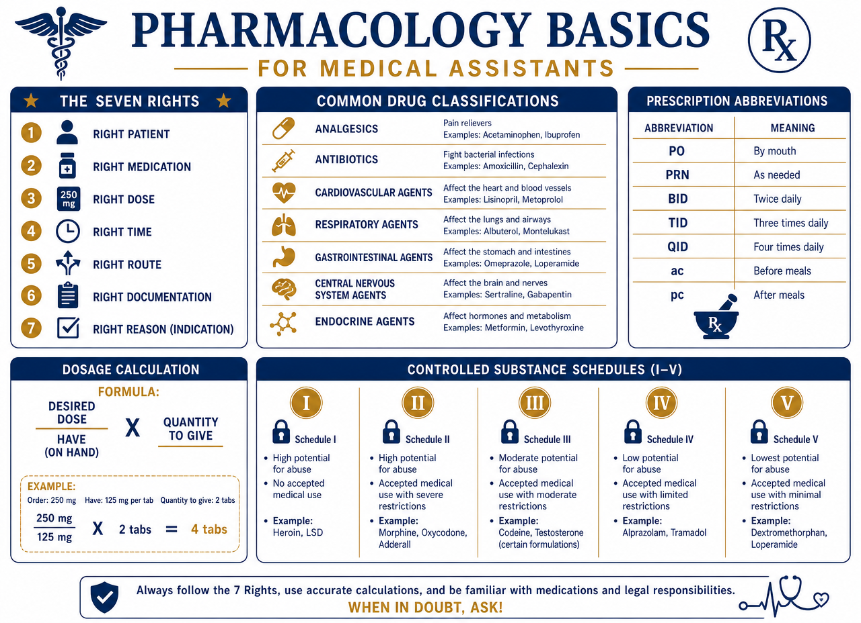
10
Basic Pharmacology
The 7 Rights · Routes · Abbreviations · Controlled Substances

Slide 66
BASIC PHARMACOLOGY
The 7 Rights of Medication Administration
Rights 1 to 4
Rights 5 to 7
1. Right Patient
  Verify full name and date of birth; never by room number.
2. Right Medication
  Read the label three times: when taking it, when preparing it, and when discarding or storing it.
3. Right Dose
  Calculate and verify; if in doubt, confirm with the physician before administering.
4. Right Route
  Oral, SC, IM, ID, topical, ophthalmic, otic, rectal, or inhaled as per order.
5. Right Time
  Respect the indicated interval; document the actual administration time.
6. Right Documentation
  Record immediately after, never before. Note site, lot, and reaction.
7. Right Education and Right to Refuse
  Explain purpose and effects; patient may refuse and it is documented.
Golden Rule
  The CMA only administers under direct physician order and supervision, within their scope of practice.
Basic Pharmacology
ICS · Institute of Health Sciences
66

Slide 67
BASIC PHARMACOLOGY
Most Used Prescription Abbreviations
Abbreviation | Meaning | Abbreviation | Meaning
PO | By mouth | q.d. / QD | Once a day
NPO | Nothing by mouth | BID | Twice a day
PRN | As needed | TID | Three times a day
STAT | Immediately | QID | Four times a day
SC / SubQ | Subcutaneous | q4h | Every 4 hours
IM · IV · ID | Intramuscular · Intravenous · Intradermal | HS | At bedtime
gtt · tab · cap | Drop · tablet · capsule | a.c. / p.c. | Before / after meals
Never guess an abbreviation: if the order is not legible or clear, ask the physician.
Basic Pharmacology
ICS · Institute of Health Sciences
67

Slide 68
BASIC PHARMACOLOGY
Dose Calculation and Classifications
Dose Calculation
Classification and Schedules
Basic Formula
  Desired dose ÷ available dose × quantity = dose to administer.
  Example: 250 mg ordered and vial is 500 mg/5 ml → 250/500 × 5 = 2.5 ml.
Equivalencies
  1 g = 1000 mg · 1 mg = 1000 mcg · 1 L = 1000 ml · 1 cc = 1 ml.
  1 kg = 2.2 lb (weight in pounds ÷ 2.2 = kg, for pediatric doses).
  1 teaspoon = 5 ml · 1 tablespoon = 15 ml · 1 ounce = 30 ml.
Common Classifications
  Analgesic (pain) · Antipyretic (fever) · Antibiotic (bacterial infection).
  Antihypertensive · Diuretic · Anticoagulant · Bronchodilator.
  Antihistamine · Antiemetic · Hypoglycemic · Sedative.
Controlled Substances (DEA)
  Schedule I: no accepted medical use, high potential for abuse (heroin, LSD).
  Schedule II: high abuse, medical use (morphine, oxycodone, methylphenidate). Locked and double counted.
  Schedule III-V: moderate to low potential (combined codeine, benzodiazepines, antitussives). Record 2 years.
Basic Pharmacology
ICS · Institute of Health Sciences
68

Slide 69
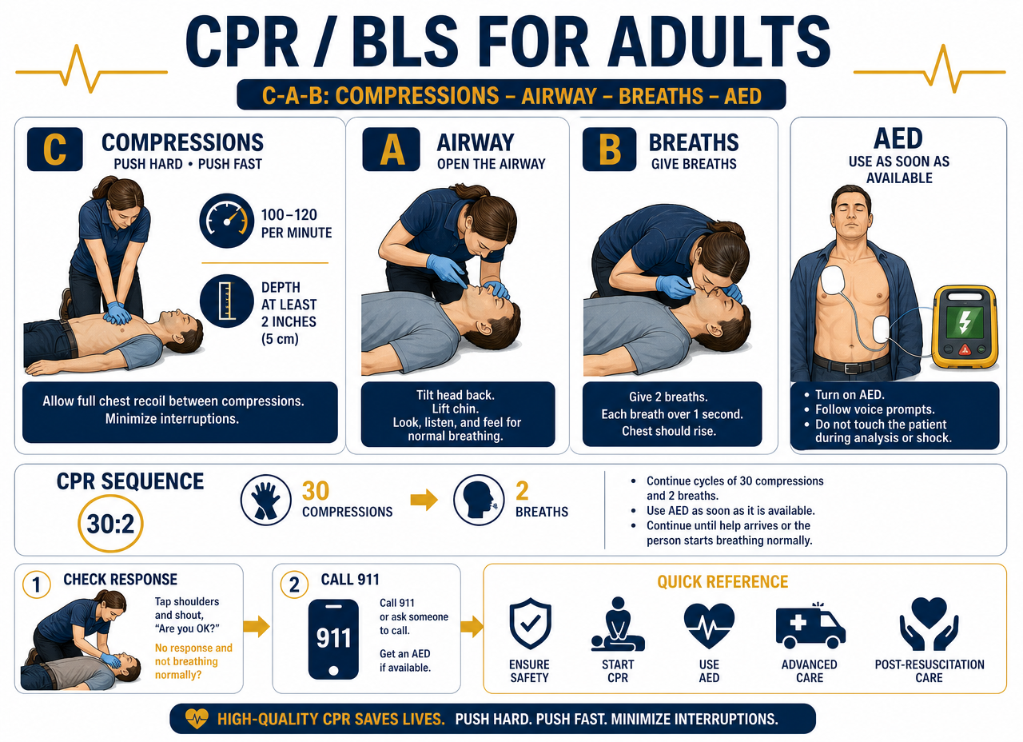
11
CPR / BLS and AED Use
Chain of Survival · Compressions · Defibrillator · Choking

Slide 70
CPR / BLS AND AED USE
Adult CPR Sequence (C-A-B)
Assessment and Compressions
Airway and Breathing
Before starting
  Verify scene safety and put on gloves.
  Check for response: gently shake and call out loudly.
  Activate the emergency system (911) and ask for the AED.
  Check pulse and breathing simultaneously (maximum 10 seconds).
C — Compressions
  Center of the chest, lower half of the sternum; heel of one hand with the other on top.
  Depth 2 inches (5 cm), rate 100-120 per minute, allow for chest recoil.
A — Airway
  Tilt head and lift chin; if cervical trauma is suspected, jaw thrust.
B — Breaths
  Ratio 30 compressions : 2 breaths of 1 second each, with visible chest rise.
  Use a pocket mask or barrier device.
Key points
  Minimize interruptions (less than 10 seconds).
  Switch rescuers every 2 minutes (5 cycles).
  Continue until advanced personnel arrive.
CPR / BLS and AED Use
ICS · Institute of Health Sciences
70

Slide 71
CPR / BLS AND AED USE
CPR by patient age
Parameter | Adult | Child (1 year - puberty) | Infant (under 1 year)
Hands | Two hands | One or two hands | 2 fingers (or 2 thumbs if 2 rescuers)
Depth | 5 cm (2 in.) | One third of chest (~5 cm) | One third of chest (~4 cm)
Rate | 100-120 / min | 100-120 / min | 100-120 / min
Ratio 1 rescuer | 30:2 | 30:2 | 30:2
Ratio 2 rescuers | 30:2 | 15:2 | 15:2
Pulse to check | Carotid | Carotid or femoral | Brachial
The quality of compressions is the most influential factor in survival.
CPR / BLS and AED Use
ICS · Institute of Health Sciences
71

Slide 72
CPR / BLS AND AED USE
AED and Choking
Automated External Defibrillator
Choking
AED use step-by-step
  1. Turn on the device and follow voice prompts.
  2. Dry the chest and shave if very hairy; remove medication patches.
  3. Place pads: one below the right clavicle, the other on the left side below the armpit.
  4. No one touches the patient during rhythm analysis.
  5. If shock is indicated, loudly announce "Clear!" and press the button.
  6. Immediately resume compressions for 2 minutes and re-evaluate.
  Pediatric pads for children under 8 years or less than 25 kg; if not available, use adult pads.
Airway Obstruction
  Mild obstruction: patient coughs forcefully and speaks — encourage them to keep coughing.
  Severe obstruction: cannot speak or cough, clutches throat (universal sign).
  Conscious adult and child: Heimlich maneuver, abdominal thrusts above the navel, upward.
  Pregnant and obese individuals: chest thrusts instead of abdominal thrusts.
  Infant: 5 back blows and 5 chest thrusts, alternating.
  If unconscious: start CPR and check the mouth before each breath.
CPR / BLS and AED Use
ICS · Institute of Health Sciences
72

Slide 73
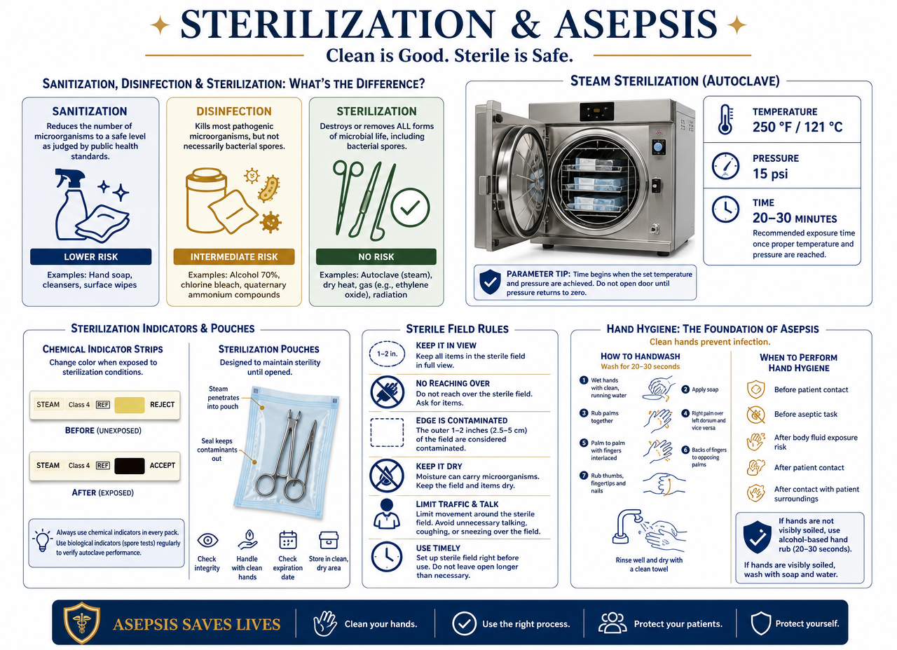
12
Asepsis, Sterilization, and PPE
Chain of Infection · Autoclave · Standard Precautions

Slide 74
ASEPSIS, STERILIZATION, AND PPE
Chain of Infection and Precautions
Chain of Infection
Types of Precautions
The 6 links
  1. Infectious agent (bacteria, virus, fungus, parasite).
  2. Reservoir (person, animal, equipment, water).
  3. Portal of exit (blood, secretions, feces).
  4. Mode of transmission (contact, droplets, airborne, vehicle, vector).
  5. Portal of entry (mucous membranes, broken skin, puncture).
  6. Susceptible host (immunocompromised, elderly, newborn).
  Breaking a single link stops the infection: hand hygiene is the most effective measure.
Standard precautions
  Treat all blood and body fluids as potentially infectious.
  Hand hygiene before and after each patient, 20 seconds with soap and water.
  Never recap needles; dispose of them in a rigid red container.
Transmission-based precautions
  Contact: gloves and gown (C. difficile, scabies).
  Droplet: surgical mask within 1 meter (influenza, pertussis).
  Airborne: N95 respirator and negative pressure room (tuberculosis, measles).
Asepsis, Sterilization, and PPE
ICS · Institute of Health Sciences
74

Slide 75
ASEPSIS, STERILIZATION, AND PPE
Medical, Surgical Asepsis, and Sterilization
Cleaning, disinfection, and sterilization
Autoclave and sterile field
Levels of control
  Sanitization: removes visible debris; cleaning with water and detergent.
  Disinfection: destroys pathogenic microorganisms, not spores (high, intermediate, or low level).
  Sterilization: destroys ALL forms of microbial life, including spores.
Medical asepsis (clean) vs. surgical asepsis (sterile)
  Medical: reduces the number of microorganisms — hand washing, clean gloves.
  Surgical: eliminates all microorganisms — sterile field, sterile gloves and technique.
Autoclave (steam under pressure)
  Typical parameters: 121 °C (250 °F) at 15 psi for 20-30 minutes.
  Instruments are washed, dried, and packed open or unlocked.
  Use external chemical indicator (color change) and biological spore test weekly.
  Label each package with date and contents; shelf life according to office policy.
Sterile field rules
  Never turn your back to the field or reach over it; anything within 2.5 cm of the edge is not sterile.
  Anything below waist level or wet is considered contaminated.
Asepsis, Sterilization, and PPE
ICS · Institute of Health Sciences
75

Slide 76
ASEPSIS, STERILIZATION, AND PPE
Personal Protective Equipment (PPE)
Correct sequence
Selection and legal backing
Order for donning PPE
  1. Hand hygiene · 2. Gown · 3. Mask or respirator · 4. Eye protection · 5. Gloves.
Order for doffing PPE
  1. Gloves · 2. Eye protection · 3. Gown · 4. Mask · 5. Hand hygiene.
  The most contaminated item (gloves) comes off first; the mask is removed by the ties, outside the room.
When to use each item
  Gloves: whenever there is contact with blood, fluids, mucous membranes, or non-intact skin.
  Impermeable gown: when splash onto clothing is anticipated.
  Mask and eye protection or face shield: risk of splash to the face.
  Fitted N95 respirator (annual fit test): airborne pathogens.
OSHA Documentation
  Exposure control plan, accessible SDS sheets, annual training, and hepatitis B vaccine offered at no cost.
Asepsis, Sterilization, and PPE
ICS · Institute of Health Sciences
76

Slide 77
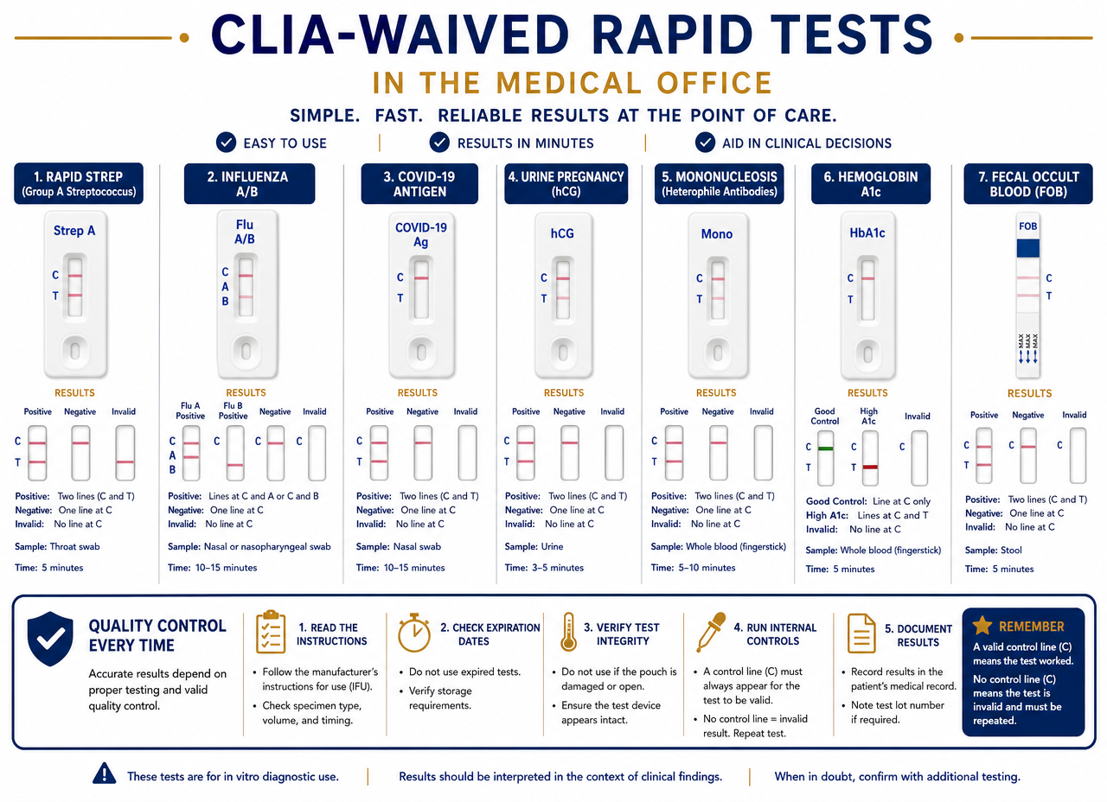
13
CLIA waived rapid tests
Strep · COVID · Pregnancy · Quality control

Slide 78
CLIA WAIVED RAPID TESTS
What are CLIA waived tests
Legal framework and best practices
Most frequent tests
Definition
  Exempt complexity tests approved by the FDA that the CMA can perform in the office (POCT) under supervision.
  Require a current CLIA Certificate of Waiver in the office.
Golden rules
  Follow the manufacturer's insert exactly: no shortcuts or approximate times.
  Check the expiration date of the kit and control before use.
  Observe the exact reading time; reading before or after invalidates the result.
  Document lot, time, result, and initials of the person who performed the test.
Common office tests
  Group A Streptococcus: tonsil and posterior pharynx swab, without touching tongue or teeth.
  COVID-19 and influenza: nasal or nasopharyngeal swab depending on the kit.
  Pregnancy (hCG): first morning urine, the most concentrated.
  Capillary glucose and waived HbA1c.
  Hemoglobin and hematocrit, urine reagent strip, fecal occult blood (guaiac).
  Mononucleosis, rapid HIV, cholesterol, point-of-care INR.
CLIA waived rapid tests
ICS · Institute of Health Sciences
78

Slide 79
CLIA WAIVED RAPID TESTS
Quality control and interpretation
Quality control
How to read and report
Quality Control (QC)
  Run positive and negative controls with each new lot, each shipment, and as indicated by the manufacturer.
  Record QC in the logbook; if it fails, DO NOT report patient results.
  Record refrigerator and room temperature daily.
  Calibrate and maintain equipment according to the manufacturer's schedule.
Cassette reading
  Control line (C): must always appear; if absent, the test is invalid and must be repeated with a new kit.
  Test line (T): its presence indicates a positive result, even if faint.
  False negative: insufficient sample, test too early, or incorrect reading time.
  Never interpret or diagnose: the CMA reports the result to the physician, who interprets it.
CLIA waived rapid tests
ICS · Institute of Health Sciences
79

Slide 80
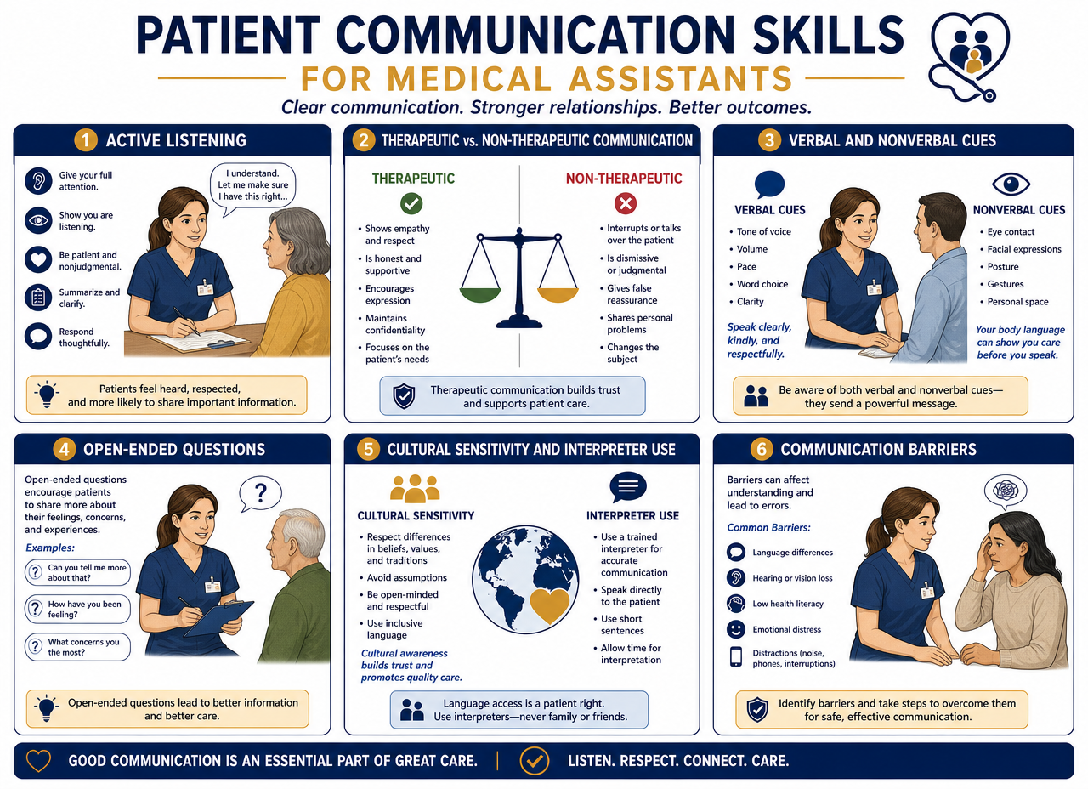
14
Communication and patient education
Barriers · Special populations · Cultural competence

Slide 81
COMMUNICATION AND PATIENT EDUCATION
Therapeutic communication and barriers
Effective communication
Obstacles and reactions
Elements of the process
  Sender, message, channel, receiver, and feedback.
  Verbal (words) and non-verbal (posture, gestures, eye contact, tone): non-verbal communicates more.
Techniques that help
  Active listening, open-ended questions, paraphrasing, and summarizing.
  Sit at eye level, call the patient by name, allow silence for response.
  Verify understanding with the "teach-back" method.
Barriers to avoid
  Using medical jargon without explanation; speaking fast or with your back turned.
  Interrupting, minimizing feelings, giving false assurances ("everything will be fine").
  Judging, giving personal advice, or changing the subject.
  Noise, rush, lack of privacy, and cultural prejudices.
Patient defenses
  Denial, regression, projection, rationalization, and displacement: recognize them without confronting.
Communication and patient education
ICS · Institute of Health Sciences
81

Slide 82
COMMUNICATION AND PATIENT EDUCATION
Special Populations and Education
Groups requiring adjustment
Culture, teaching, and privacy
Elderly
  Speak clearly and slowly face-to-face, without shouting; provide written instructions in large print.
  Allow more time and confirm they are using glasses or hearing aids.
Pediatric
  Simple and honest words; include the caregiver; never say "it won't hurt".
Disability
  Deafness: look face-to-face, use paper and pencil or a sign language interpreter.
  Blindness: announce yourself upon entering, describe each step, and offer your arm.
  Cognitive: one instruction at a time, repeat calmly.
Cultural Competence
  Respect beliefs, diet, modesty, and family roles in health decisions.
  Use a qualified interpreter, not family members or children; speak to the patient, not the interpreter.
  Avoid assumptions about physical contact, eye contact, or personal space.
Patient Education
  Teach in an unhurried environment; combine explanation, demonstration, and printed materials.
  Confirm with teach-back and document what was taught and who was present.
  Remember HIPAA: never discuss patient information in public areas or with unauthorized third parties.
Communication and patient education
ICS · Institute of Health Sciences
82

Slide 83
Quick review before the exam
20/40
30°
2-8 °C
Sees at 20 feet what a normal person sees at 40
Venipuncture angle, bevel up
Vaccine refrigerator
INR 2.0-3.0
Rule of 15
45° · 90° · 10-15°
Therapeutic range
15 g of carbohydrates, re-evaluate in 15 min
SC / IM / ID injection angles
ICS · Institute of Health Sciences | CRUZ Home Care & Educational Services

